Slide 1
Parenting Tips and Understanding Through a Pandemic Succeeding at finding out what works and what doesn’t is not failure. CARYL WARD LCMHC,CFLE carylscounseling@gmail.com 801.999.0179

Slide 2
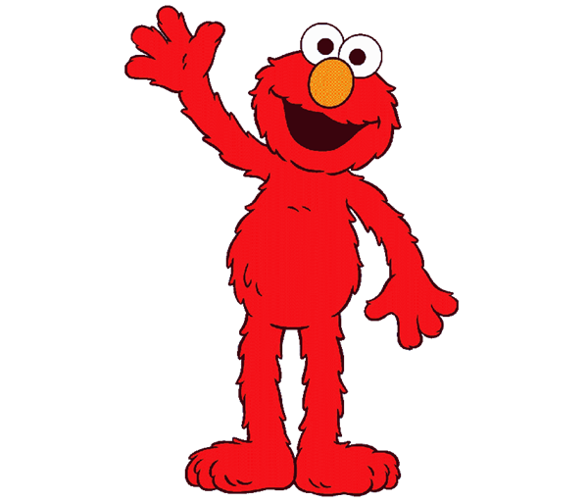
Virtual Times From Elmo
https://www.sesamestreet.org/caring
https://www.fredrogers.org/coronavirus/

Slide 3
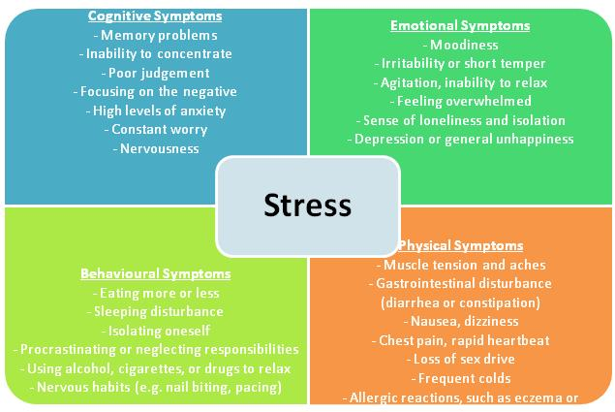
101 Parenting with the Unseen
Explanation of what Unknown’s and the Unseen's traumas do
Self Discipline to Prevent Burnout
My Five R’s–
Routine,
Responsibly,
Reassurance,
Reward,
Resilience
Balance—Time/Energy/Money
Physical, Mental, Social, Emotional/Spiritual

Slide 4
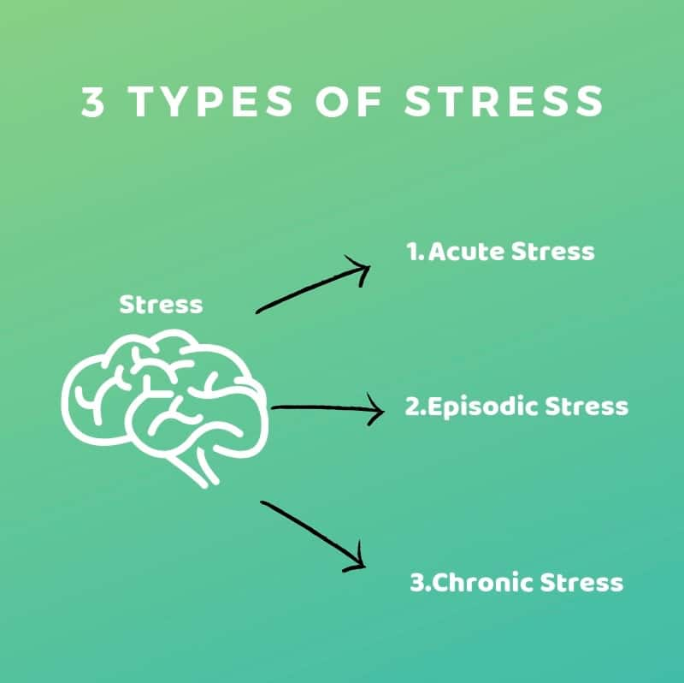
The Unknowns & The Unseen
Traumatic Events
Acute Stress
One Month, Short Term
Adjustment
Six Months
Post Traumatic
Three-Six Months Plus, Long Term
Trauma Emotions of Loss, Grief, Powerless
Unseen vs. Seen

Slide 5
The Five R’s of Self-Discipline
Routine- Find new traditions, play, and creative TIME together
Responsibly- Love & Logic = Choices = Power = Thinking Words not Fighting Words
Reassurance- Model emotions by validation and empathy
What about all those ?’s
Reward- Set up new Reward System (by your child’s Love Languages)
Resilience- Instill HOPE by telling the story

Slide 6
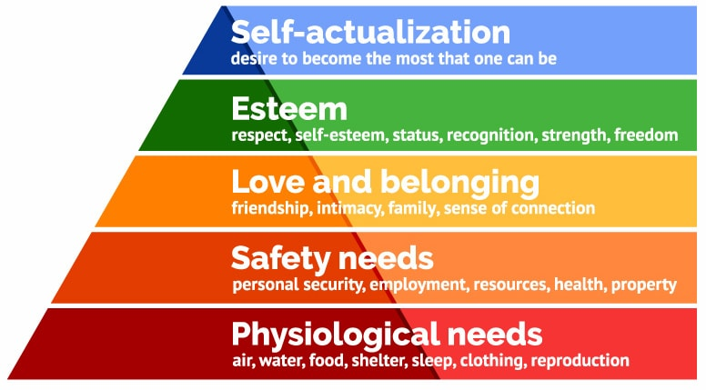
Balance- Mind Body Soul

Slide 7
Balance- Mind Body Soul
Emotion
Spiritual
Emotional Intelligent
Physical
Sleep
Mental
Brain power
Social
Family
Diet
Exercise
New tasks
Friends
Community
Grounded
Connection
Judgment

Slide 8
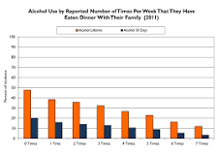
Physical Balance
Sleep
Even more important to sleep well to reduce panic and depression
Bed time routine tips-Sleep only in the bed. Magnesium. Get out after 20 mins.
Diet
Hard to eat fresh healthy fruits and vegetables but family dinner is a must!
Exercise/Movement
Gym is out! Sports are Out!
Exercise outside/Inside?
Without it…taxing on our immune systems
Movement Apps
Gaming?
(https://youthservicesslc.wordpress.com/2012/06/05/3-reasons-for-family-dinner)

Slide 9
Physical Balance –Immune system
Supplements for kids!
Vitamin D3
Vitamin C
Zinc
Magnesium
B6
Apple Cider Vinegar
Turmeric

Slide 10
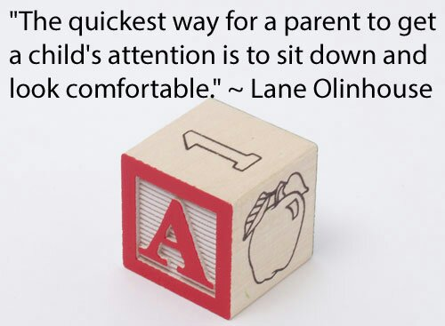
Mental Balance
Creative Play Activates
Limit Screen Time
Good Distractions 10 minutes-1 hour
vs. Avoidances-2 hours plus
Timer as the BOSS for Homework
Create a Mental “Safe Space”
Need—Hula-Hoop, Desk, Stress Bag, Signs (Mommy’s on a call),
five senses bag

Slide 11
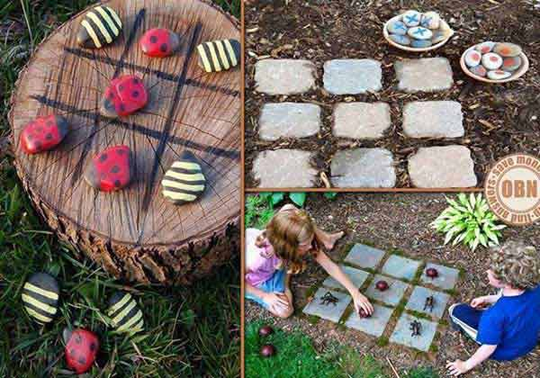
Social Balance
Social Distancing does not mean Social Disconnecting
Get Creative!
Get old school and new school
Talk about Fears and Missing
Connect through Empathy

Slide 12
Emotion/Spiritual Balance Step 1
1. OBSERVE
Note mental and physical feeling
Label Primary and Secondary Emotion (10-30)
Rate your emotion 1-10
Release Fight, Flight, and Freeze to achieve Wise Mind (frontal lobes)
Record Daily

Slide 13
Emotion/ Spiritual Balance Step 2
2. EXPERIENCE
Try not to Block or Push it (Don’t stuff or Judge)
Be a witness to the emotion
Be present/ Be mindful
Observing 5 senses
No Shame all emotions are signs

Slide 14
Book References
Chapman & Campbell (2012) The Five Love Languages of Children
Cline, Fay (2016) Parenting With Love And Logic
Cline, Fay (2016) Parenting Teens With Love And Logic: Preparing Adolescents for Responsible Adulthood
Gottman (1997) Raising An Emotionally Intelligent Child

