Slide 1
Emotional Coaching Recognize all emotions as being natural and normal and not always a matter of choice.
Caryl Ward LCMHC, CFLE carylscounseling@gmail.com 801.999.0179 cell

Slide 2
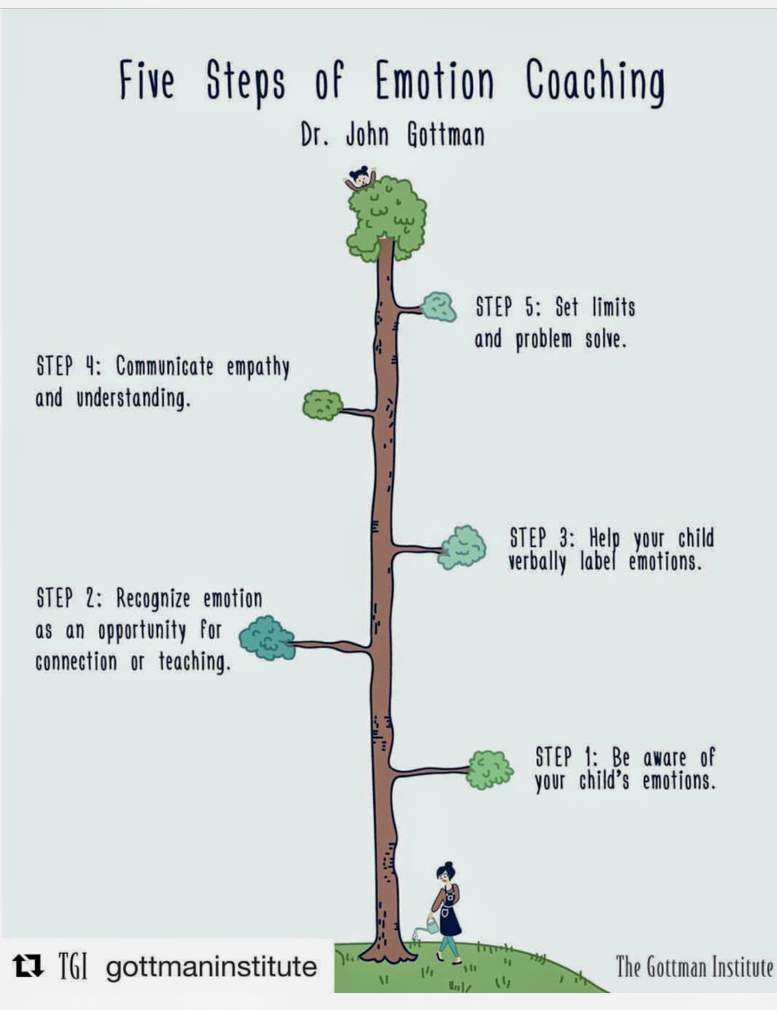
Emotion Before Behavior…
“Much of today’s popular advice ignores the world of emotions. Instead, it relies on child-rearing theories that address the children’s behavior, but disregard the feelings that underlie that behavior” (Gottman, 1997)

Slide 3
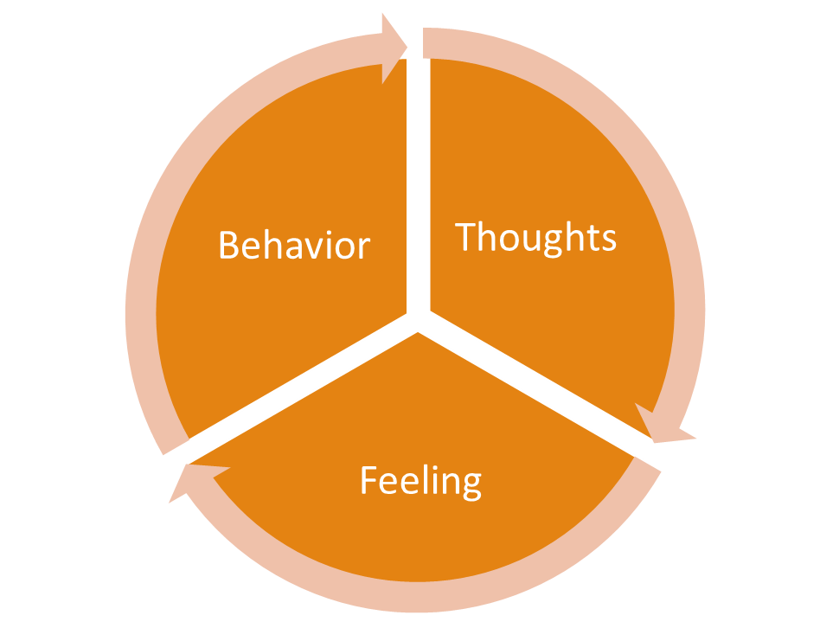
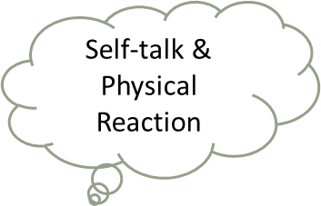
Brain Cycle
FRONTAL LOBES
SELF-TALK
Physical Response
Reward System
Reasoning
Emotions/Logic

Slide 4
Emotion ¼ of your Balance

Slide 5
Primary Emotions
Shame
Worthless
Loss
Grief
Weak
Powerless
Sad
Mad
Surprised
Peaceful
Happy
Shame

Slide 6
Primary Emotions
Happy
Hopeful
Worth
Higher Purpose
Safe
Understood
Sad
Mad
Surprised
Peaceful
Happy
Shame

Slide 7
Secondary Emotions
Frustration
Outraged
Insecure
Lonely
Worthless
Jealous
Annoyed
Hurt
Resentment

Slide 8
Shame CYCLE

Slide 9
Steps to Emotional Intelligence
Become Aware and Intelligent of ALL Emotions
Recognize an Opportunity for Teaching and Intimacy
Listen, Validate, and Reflect
Coach the Child to Label How They Feel
Set Limits and Problem Solve (Gottman 1997)

Slide 10
1. Become Aware and Intelligent of ALL Emotions
The parent must be aware of and be comfortable with their own emotions first and experience them daily. It is crucial in allowing for all feelings in a non-shaming way. Start by writing down your secondary emotions everyday. Try to find at the least 30. Help your child find 10.
TIPS– Put up a poster of emotions on the fridge. Smaller children will just need faces of emotions. Put a white board with different colors of markers in a common area in the house to go to after a strong emotion. Keep emotional journals that are color coordinated. Emotion bags of SAD or MAD or HAPPY. Put things in that bag that add to that emotion and help self-regulate.

Slide 11
2. Recognize an Opportunity for Teaching and Intimacy
As parents we need to teach by modeling empathy, to build intimacy, trust, how to “sit” in a strong emotion, and how to produce a behavior after the emotion. All emotions are not a threat to our authority or something WE need to FIX.
TIPS—Show that you are their ally and face struggle together…that they are not alone or weak. Know what empathy really is. Be constituent with your response and emotion and model that. Children will mirror you!

Slide 12
Empathy VS Sympathy
“When you get to a place where you understand that love and belonging, your worthiness is a birthright and not something you have to earn, anything is possible.” BB
https://youtu.be/1Evwgu369Jw

Slide 13
3. Listen, Validate, and Reflect
You can listen in many different ways to your child. With physical evidence, seeing your child's perspective, and with reflection of facial response. But most important with your heart. “I can see why you would be so upset, I would be too,”
TIPS—Observation is best! State what you see, hear, feel, touch! No correction, or fixing at this point. No questions, just statements.

Slide 14
4. Coach the Child to Label How They Feel
After you have listened and empathized, and been in their “space”, you label and/or investigate the emotion your child is having in that moment. State what you see and hear, not what the child OUGHT do or feel. Explain when the last time you felt this way if appropriate. Label and investigate several secondary emotions.
TIPS—Try this verbiage! You look_____. It seems_____. Its normal for______. I can see_____. What does your body feel like? I see that you are crying, kicking, yelling, shaking, etc. Put a number on it, 1-10. 10 being an extreme.

Slide 15
5. Set Limits and Problem Solve
There are five steps inside this step!
1. State clear limits on behaviors, actions, appropriate wishes that align with your family value system (if you don’t know what those are, find them). Provide pre-set consequences that are consistent and fair related to the behavior not the emotion.
2. Identify the goal and what you would like to accomplish with this strong emotion and if it resulted in a behavior that needs to be repaired go to a solution (broken item from a tantrum).
3. Think of a possible solution towards the goal and what works best for self-regulation, recognizing emotion, or just sitting in it.
4. The solutions have to align with your family values and the child’s.
5. Help your child to find solutions by choices, encouragement, coaching, challenging, and processing the outcome with logical thinking. Sometimes a good distraction helps!

Slide 16
Emotion/Spiritual Balance Step 1
1. OBSERVE
- Note mental and physical feeling
- Label Primary and Secondary Emotion (10-30)
- Rate your emotion 1-10
- Release Fight, Flight, and Freeze to achieve Wise Mind (frontal lobes)
- Record Daily

Slide 17
Emotion/ Spiritual Balance Step 2
2. EXPERIENCE
- Try not to Block or Push it (Don’t stuff or Judge)
- Be a witness to the emotion
- Be present/ Be mindful
- Observing 5 senses
- No Shame all emotions are signs

Slide 18
Lets get HAPPY… Tips to produce happy hormones!

Slide 19
Boost it!

Slide 20
Boost it!
Activates for Kids
Supplements
Vitamin D3
Vitamin C
Zinc
B6
Magnesium (citrate)
Apple Cider Vinegar
L-Tyrosine
L-Theanine
Iron
Protein
Sleep!!
Arts and Crafts
Creativity
Movement
Music
Pets
Walking
Writing/tracing/coloring

Slide 21
References
Brown, B. (2010). The power of vulnerability. TED Talk.
Brown (2010). The Gifts of Imperfection: Let Go of Who You Think You’re Supposed to Be and Embrace Who You Are
Brown (2012). Listening to Shame. TED Talk
Brown (2012). The Gifts of Imperfect Parenting. Audible
Brown (2015). Rising Strong: How the Ability to Reset Transforms the Way We Live, Love, parent, and lead
Gottman, J. M. & DeClair, J. (1997). The Heart of Parenting: Raising
an Emotionally Intelligent Child. New York: Simon & Schuster.
Siegel, D. J., & Payne Bryson, T. (2011). The whole-brain child: 12 revolutionary strategies to nurture your child's developing mind. Bantam Books.
Tuning in to Teens Handouts 2,3,4,5 and 6 CARE
https://www.ehcap.co.uk/content/sites/ehcap/uploads/NewsDocuments/297/MEC-No-NOTES-22-April.PDF

