Slide 1
Irritability is Not My Style! CARYL WARD LCMHC, CFLE caryl@blomquisthale.com 801.999.0179 cell 801.262.9619 office

Slide 2
“Anybody can become angry – that is easy, but to be angry with the right person and to the right degree and at the right time and for the right purpose, and in the right way – that is not within everybody’s power and is not easy.” Aristotle

Slide 3
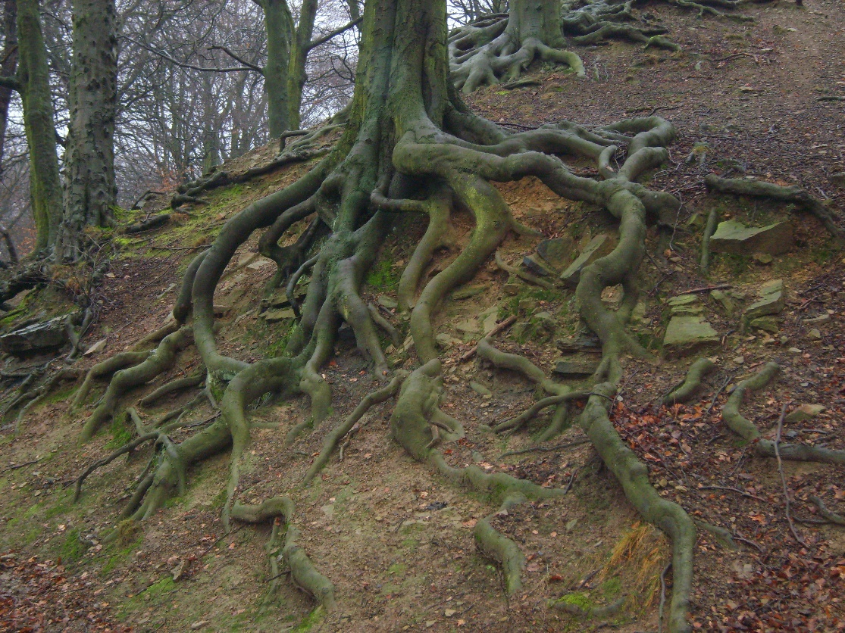
The Roots to Irritability
Define Anger
How is pressure or powerless hijacking your emotions
What battles within your internal-self are you fighting
Boundaries not Battles within
Roots vs. Values and how they grow
How to feed new outlets to self-power

Slide 4
Anger Myth’s
Anger is inherited
Anger leads to aggression/Rage
Anger gets what you want
Anger is not a habit
Anger is a primary emotion
Venting anger physically is therapeutic

Slide 5
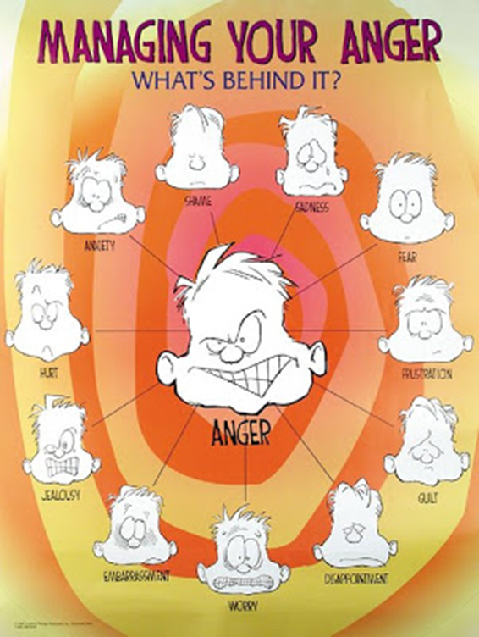
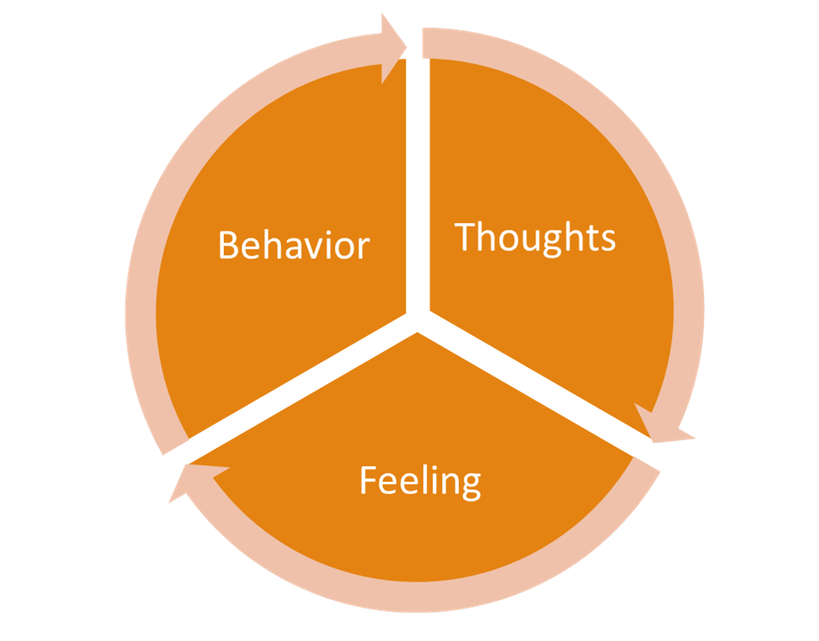
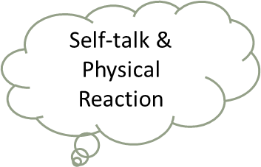
Define Anger (FIGHT)
Three types of anger
Aggressive- Direct with Disrespect (FIGHT)
Passive Aggressive- Yes but You mean No (FLEE)
Passive- Everyone is Right and You are Wrong(FREEZE)
Assertive- Direct with Respect
(I feel, I need, I am willing to do)
Clue-Always a Cycle
Thinking Error
Emotional
Physical Reaction
Behavioral

Slide 6
Hijacked Emotions
Frustration
Outraged
Insecure
Lonely
Worthless
Jealous
Annoyed
Hurt
Resentment
Don’t Let Chemicals Hijack the Brain
Allow Time and Practice
Two Chemicals- Love or Fear
Ask yourself- What are my unresolved/buried feelings and the belief system behind them?
Get to the ROOT to reduce stress and sickness!

Slide 7
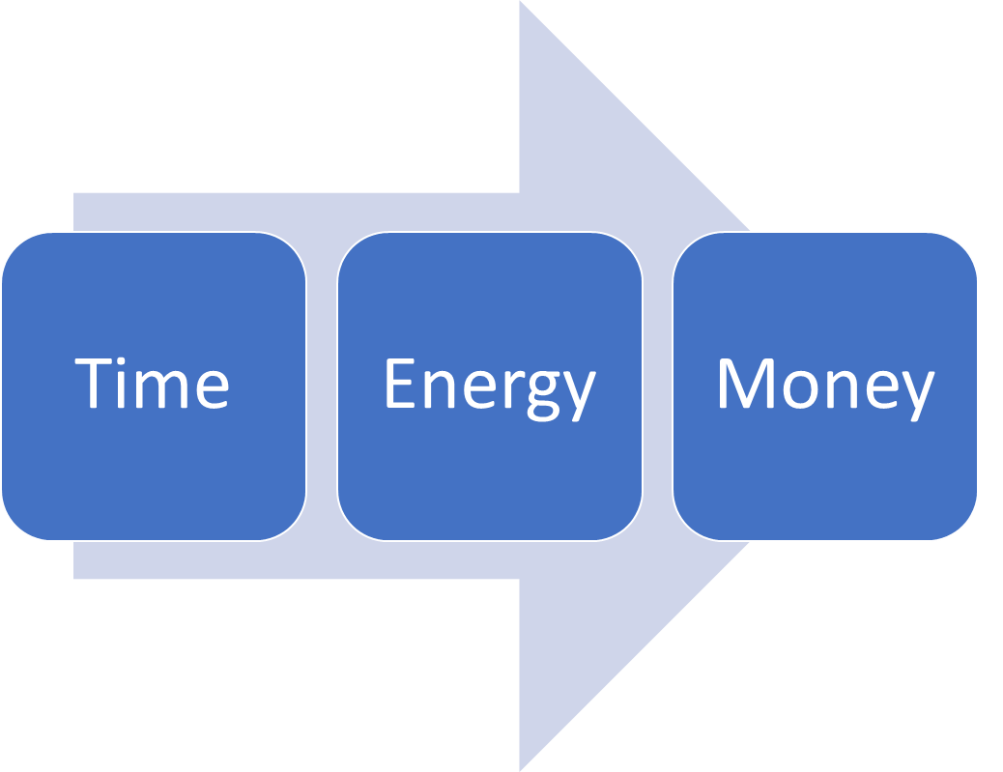
Values

Slide 8
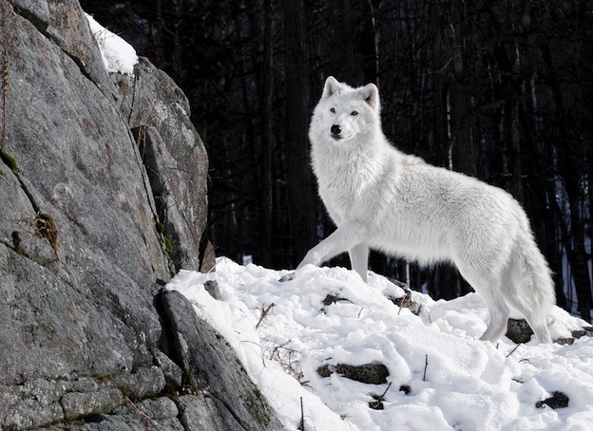
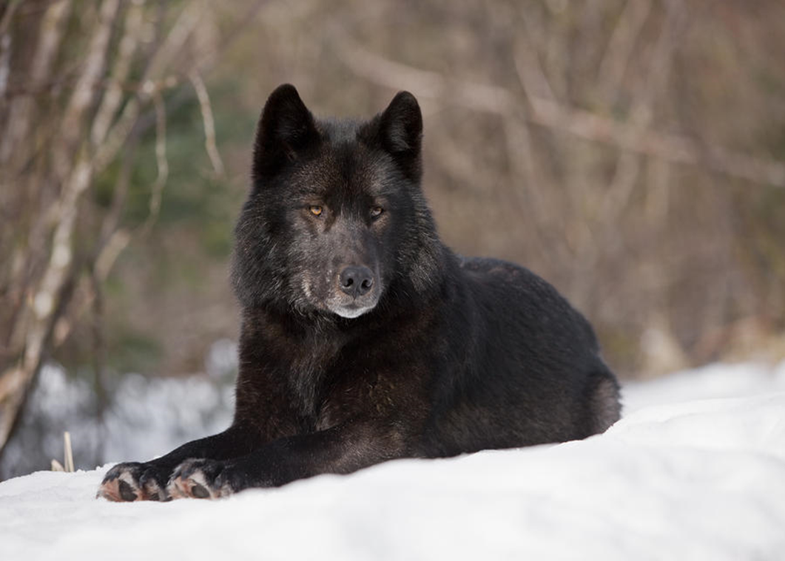
Battles Within Your Internal-Self
Notes:
An old Cherokee is teaching his grandson about life. “A fight is going on inside me,” he said to the boy. “It is a terrible fight and it is between two wolves. One is evil – he is anger, envy, sorrow, regret, greed, arrogance, self-pity, guilt, resentment, inferiority, lies, false pride, superiority, and ego.”
He continued, “The other is good – he is joy, peace, love, hope, serenity, humility, kindness, benevolence, empathy, generosity, truth, compassion, and faith. The same fight is going on inside you – and inside every other person, too.”
The grandson thought about it for a minute and then asked his grandfather, “Which wolf will win?”
The old Cherokee simply replied, “The one you feed.”

Slide 9
Feed the New Power Outlet
Choose to Feed the Junk Values or Treasured Values?
“How can we expect people to put value on our work when we don’t value ourselves enough to set and hold uncomfortable boundaries?”
Brown (2015) Rising Strong, pg. 115

Slide 10
Boundaries =No Battles
Be assertive with Body language, call it what it is, I feel/I need/I will statements
Know your value system
Know your Secondary Emotion (Fear)
Be present-FFF does not work
Give yourself permission
Go by patterns not potential
Know self-care needs
Know when your values have been crossed
Know your rights, don’t apology
Rehearse and Repeat

Slide 11
Boundaries Continued…
Guidelines, rules, expectations, limits, needs, protection, empowering, communication, healthy, personal, assertive, respectful, valuable, difficult, dividing line, balance, vulnerability, equalizes, modeling, teaching, responsivity, courageous, safety, preserve and deepen relationships
Six types
Physical—personal space, and physical touch
Intellectual—refer to thoughts and ideas. Dismissing or belittles ideas or options
Emotional—personal feelings and limits to share and invalidates
Sexual—emotional, intellectual, and physical aspects of sexuality, unwanted pressure
Material—personal money or possessions of materials
Time—how time is spent or violated from an other person
Tip-Just pick one category/type and improve it over a month within your relationships

Slide 12
Roots
Leafy Issue
Failed relationships, Financial Issues,
Junk Values, Addiction, Thinking Errors
Trunk
2nd Emotion
Hurt, Inadequate, Raw, Stuck,
Fear, Anger, Betrayed, Hopeless
Root Issue
Loss, Grief, Trauma (developmental, relational, etc.), Self-Concept, Abandonment, Shame, Denial, Metal Health, Chronic Health

Slide 13
How Do Roots Grow?
Irritability
Stuffing/Denial
Overwhelmed
Emotional Numbness/ Rage
Depression/Anxiety
Fatigue Burnout
Shame
Thinking Errors
Compassion, Courage, Connection
Except
Connect with the Unharmed
Holding the Hurt
Attunement
Release Shame
Power
Grounded/Balance

Slide 14
Practice Love not Fear
For twenty minutes each morning (or at any time), practice the following meditation on mindful loving.
State an aspiration. For example, “Today, may I think, speak, and act toward my beloved with as much generosity, kindness, and compassion as I am able.”
Bring your attention to your feet. Ground yourself in the body. Slowly scan your body from feet to head, connecting with it and gently observing it.
Bring your attention to your breath. Invite the mind to settle. Using the breath as the meditation object, practice mindfulness for approximately five minutes. If the mind wanders, gently refocus on the breath.
Slowly bring your attention to the day ahead. Scan through the day to come: your plans, obligations, intentions. Where does your love relationship fit into your day today? Select one or two positive, wholesome love priorities. Perhaps decide to skip your favorite TV show so you can make your mate a lovely meal. Don’t overthink it—trust whatever arises and feels like a loving relationship priority for the day to come.
Mentally review your passion plan and recommit to your daily commitments.
Place your palm on your heart and take three breaths into and out from your heart center. Bring to mind three things you appreciate about your beloved.
Allow all that to fade away and take one more mindful breath.
Repeat your aspiration. Create a mindful loving day, regardless of circumstances.

Slide 15
References
Brown, B. (2015). Rising strong: The reckoning. The rumble. The revolution. New York: Spiegel & Grau.
Cloud (2001). Boundaries with Kids
Cloud (2002). Boundaries in Marriage
Covey, S. R. (1989). The seven habits of highly effective people: restoring the character ethic. New York: Simon and Schuster.
Hari, J. (2018). Lost connections: Uncovering the real causes of depression-- and the unexpected solutions.
Lerner, H. G. (1986). The dance of anger: A woman's guide to changing the patterns of intimate relationships.
Lerner, H. G. (2017). Why won’t you apologize? Healing big betrayals and everyday hurts.
Patterson, Kerry. (Eds.) (2012) Crucial conversations: tools for talking when stakes are high New York : McGraw-Hill
Truman (2003). Feelings buried alive never die. Olympus Distributing
Van der Kolk, B. A. (2014). The body keeps the score: Brain, mind, and body in the healing of trauma. New York: Viking.

