Slide 1
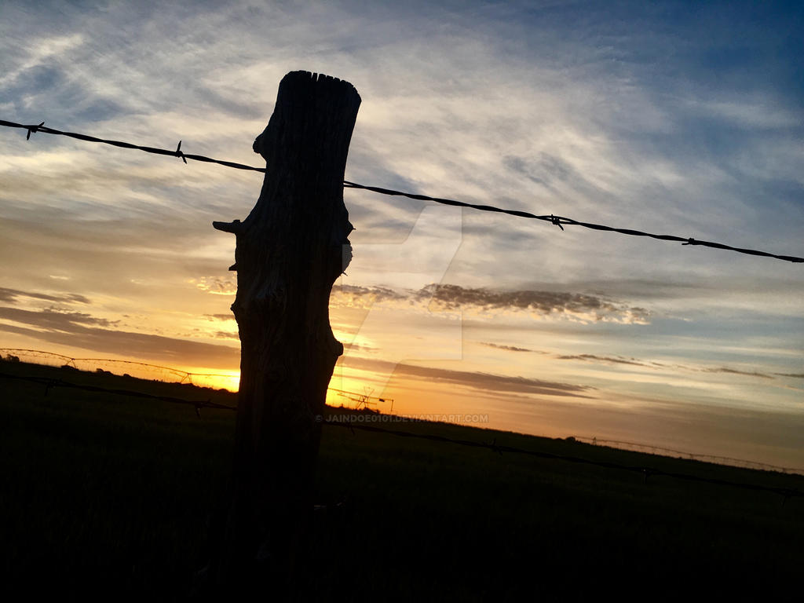
Caryl Ann Ward LCMHC, CFLE carylscounseling@gmail.com 801.999.0179 cell
Boundaries and Assertive Behavior Part II

Slide 2
Why Boundaries…
Better Mental and Emotional Health
Avoidance of Burnout and Better Balance
Development of Autonomy and Identity
Reduction of Relational Trauma and Shame
What are boundaries
Why we need them
Triangle trap with Toxic Behavior
Enmeshment
Assertive behavior and repair
Take home

Slide 3
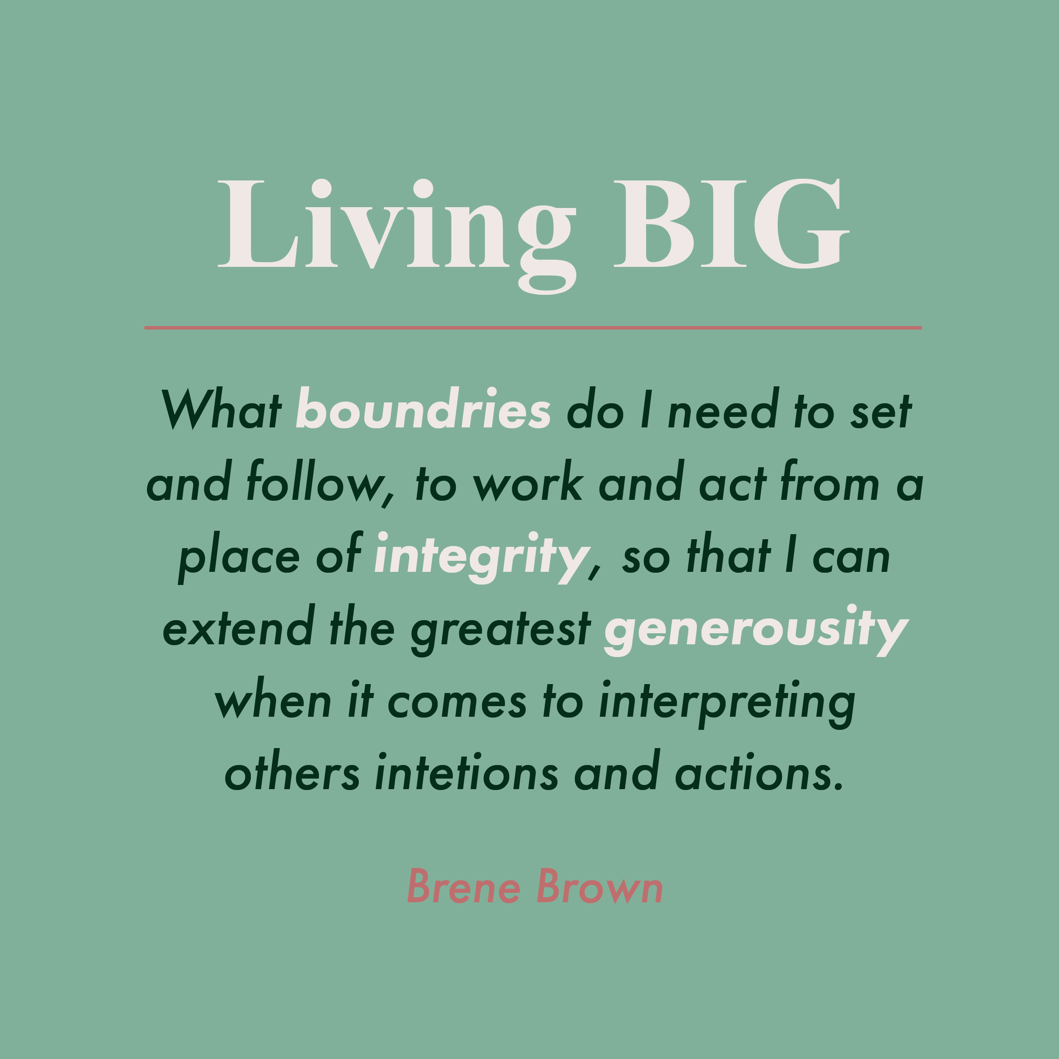
Boundaries-The Key to Self-Love

Slide 4
B.I.G. B.R.A.V.I.N.G
https://www.youtube.com/watch?v=5U3VcgUzqiI (Brene Brown)
Boundaries | You respect my boundaries, and when you’re not clear about what’s okay and not okay, you ask. You’re willing to say no. Reliability | You do what you say you’ll do. At work, this means staying aware of your competencies and limitations so you don’t over promise and are able to deliver on commitments and balance competing priorities. Accountability | You own your mistakes, apologize, and make amends. Vault | You don’t share information or experiences that are not yours to share. I need to know that my confidences are kept, and that you’re not sharing with me any information about other people that should be confidential. Integrity | You choose courage over comfort. You choose what is right over what is fun, fast, or easy. And you choose to practice your values rather than simply professing them. Nonjudgment | I can ask for what I need, and you can ask for what you need. We can talk about how we feel without judgment. Generosity | You extend the most generous interpretation possible to the intentions, words, and actions of others.

Slide 5
boundaries are…
Guidelines, present, rules, expectations, limits, needs, protection, empowering, communication, healthy, personal, assertive, respectful, valuable, difficult, dividing line, balance, vulnerability, equalizes, modeling, teaching, appropriate, responsivity, clear, firm, courageous, safety, preserve and deepen relationships
Six types
Physical—personal space, and physical touch
Intellectual—refer to thoughts and ideas. Dismissing or belittles ideas or options
Emotional—personal feelings and limits to share and invalidates
Sexual—emotional, intellectual, and physical aspects of sexuality, unwanted pressure
Material—personal money or possessions of materials
Time—how time is spent or violated from an other person
Tip-Just pick one category/type and improve it over a month within your relationships

Slide 6
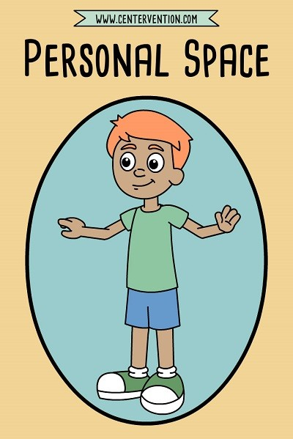

Slide 7
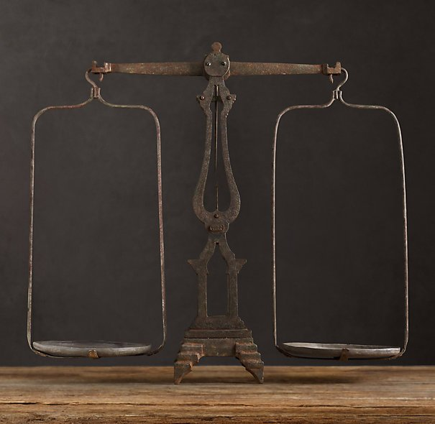
boundaries are not…
Boundaries aren't just something you have with other people
To fix, change, or punish the receiver or giver
For the receiver or violator to blame, shame, label, or guilt trip
To be ignored or be Unequal
To be aggressive or passive
Impersonal
Against your value system

Slide 8
10 Ways to Have Boundaries & Values
Be assertive with Body language, call it what it is, I feel/I need/I will statements
Know your value system
Know your Secondary Emotion (Fear)
Be present-FFF does not work
Give yourself permission
Go by patterns not potential
Know self-care needs
Know when your values have been crossed
Know your rights, don’t apology
Rehearse and Repeat

Slide 9
Ten Laws of Boundaries
According to the authors, John Townsend and Henry Cloud, there are ten laws of boundaries:
The Law Of Sowing and Reaping - Actions have consequences. If someone in your life is sowing anger, selfishness, and abuse at you, are you setting boundaries against it? Or are they getting away with not reaping (or paying the consequences for) what he/she sowed?
The Law of Responsibility - We are responsible TO each other, not FOR each other. This law means that each person refuses to rescue or enable another's immature behavior.
The Law of Power - We have power over some things, we don't have power over others (including changing people). It is human nature to try to change and fix others so that we can be more comfortable. We can't change or fix anyone - but we do have the power to change our own life.
The Law of Respect - If we wish for others to respect our boundaries, we need to respect theirs. If someone in your life is a rager, you should not dictate to him/her all the reasons that they can't be angry. A person should have the freedom to to protest the things they don't like. But at the same time, we can honor our own boundary by telling them, "Your raging at me is not acceptable to me. If you continue to rage, I will have to remove myself from you."
The Law of Motivation - We must be free to say "no" before we can wholeheartedly say "yes".One can not actually love another if he feels he doesn't have a choice not to. Pay attention to your motives.
The Law of Evaluation - We need to evaluate the pain our boundaries cause others. Do our boundaries cause pain that leads to injury? Or do they cause pain that leads to growth?
The Law of Proactivity - We take action to solve problems based on our values, wants, and needs. Proactive people keep their freedom and they disagree and confront issues but are able to do so without getting caught up in an emotional storm. This law has to do with taking action based on deliberate, thought-out values versus emotional reactions.
The Law of Envy - We will never get what we want if we focus our boundaries onto what others have. Envy is miserable because we're dissatisfied with our state yet powerless to change it. The envious person doesn't set limits because he is not looking at himself long enough to figure out what choices he has.
The Law of Activity - We need to take the initiative to solve our problems rather than being passive.In a dysfunctional relationship, sometimes one person is active and the other is passive. When this occurs, the active person will dominate the passive one. The passive person may be too intimidated by the active one to say no. This law has to do with taking initiative rather than being passive and waiting for someone else to make the first move.
The Law of Exposure - We need to communicate our boundaries. A boundary that is not communicated is a boundary that is not working. We need to make clear what we do or do not want, and what we will or will not tolerate. We need to also make clear that every boundary violation has a consequence. A boundary without a consequence is nagging.

Slide 10
Stephan Kapman Conflict Triangle
PARENT
ADULT
CHILD

Slide 11
Understanding Enmeshment
Many people don't realize they are part of an enmeshed family until they're well into adulthood, and some individuals never recognize the signs.
Enmeshment involves blurred or nonexistent boundaries, unhealthy family patterns, control, social problems, a dysfunctional relationship pattern, and lack of independence and individuality.
Deeply ingrained
Inappropriate roles/Parent/Child
Unhealthy attachment
Lack of Space/Time/Privacy
Fear of Conflict, Shame, Anxiety
Unhealthy boundaries
Unclear Identity
Effects—self-esteem, substance abuse, physical health issues, unstable relationships, unhealthy modeling, mental health disorders

Slide 12
What Happens to You…
You’re emotionally affected by their drama (shut down)
You dread (fear) being around them (avoid)
You’re exhausted or you feel angry while you’re with them or after your interaction (drained)
You feel bad or ashamed about yourself (worthless)
You’re stuck in a cycle of trying to rescue, fix or be the care-giver (syndrome)
Loose your values (self-worth)
Become burnt-out (relationship burnout, FFF)
You enter a syndrome (codependent)

Slide 13
Check in…?’s
Do you often feel angry and resentful because you feel taken advantage of?
How often do I worry about what other people think?
Do I feel guilty for wanting to do things by myself?
When did I last say no to someone?
When did I last say yes to something I secretly didn’t want to do?
Do I feel like I deserve respect or I have to earn it by being ‘nice’?
What are the five rules to being my friend? Do I know them quickly and easily?
What are the 10 things I most like to do with my time? Can I quickly come up with them?
What are the 10 things I hate doing? Do I even have strong feelings about things?
When I think about saying no to someone, do I feel afraid? Or calm inside?

Slide 14
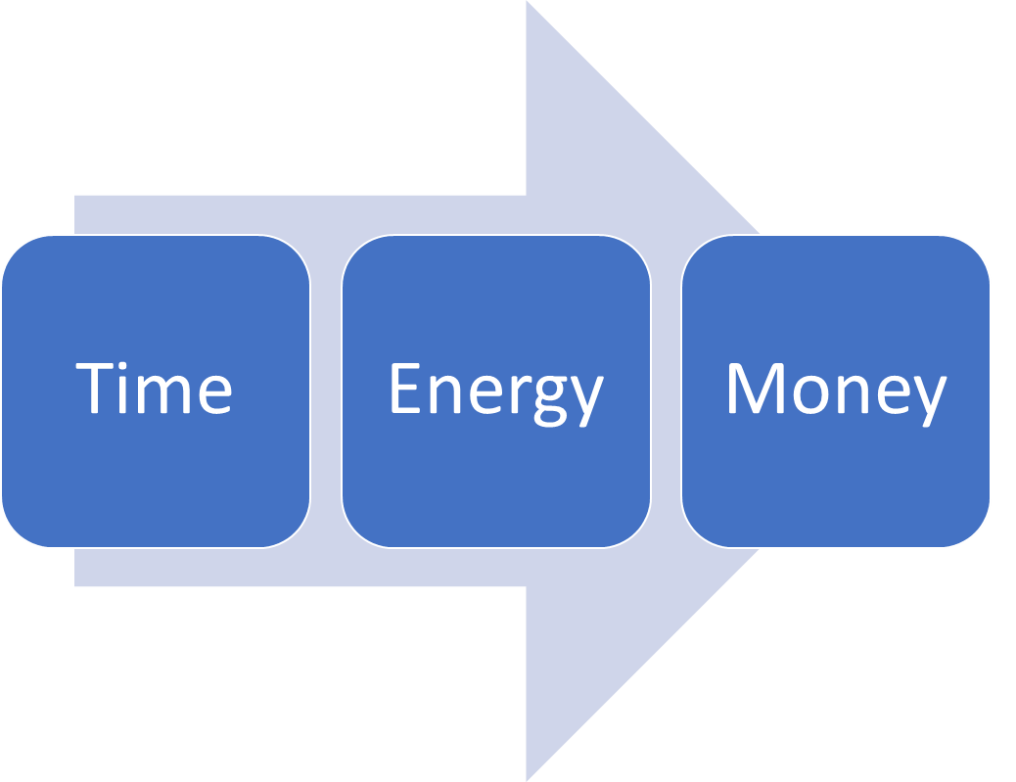
By Knowing your Values

Slide 15
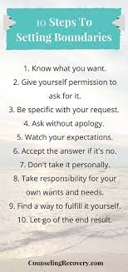
Begin Setting Personal Boundaries
Short-I feel, I need, I am willing to
Clear-Expectations
Purpose-Higher Purpose connected to your VALUES
Protects-You/Know your Deal Breakers
Repeat-If needed

Slide 16
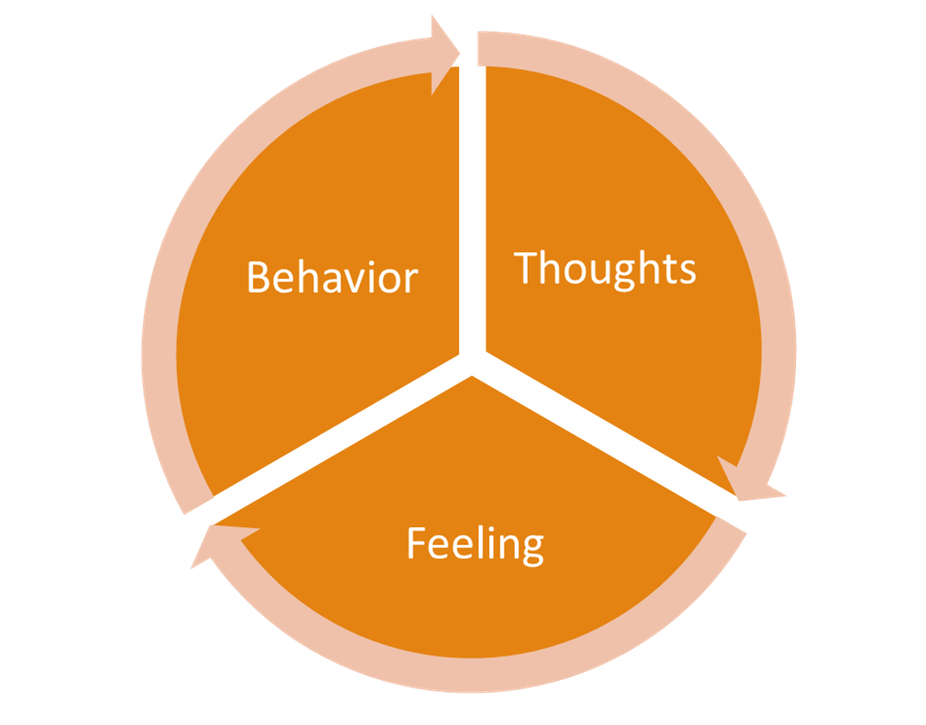
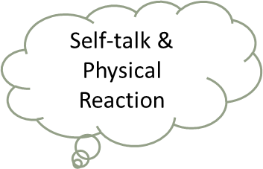
Assertive Behavior
Three types of Behavior
Aggressive- Direct with Disrespect (FIGHT)
Passive Aggressive- Yes but You mean No (FLEE)
Passive- Everyone is Right and You are Wrong(FREEZE)
Assertive- Direct with Respect
(I feel, I need, I am willing to do)
Clue-Always a Cycle
Thinking Error
Emotional
Physical Reaction
Behavioral
BRAIN

Slide 17
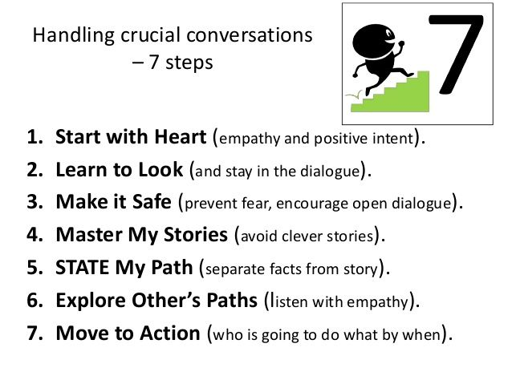
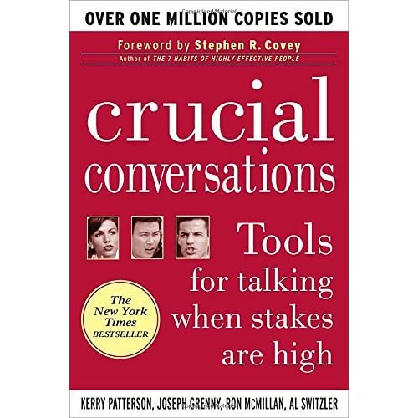
Assertive- Direct with Respect
I feel
I need
I am willing to do
I am not willing to do

Slide 18
Rinse and Repeat
People who don’t respect boundaries have certain traits that make it challenging for others to speak up. They expect to get their own way; Ignore or don’t comprehend what others want; Don’t compromise easily; Get defensive when challenged; Try to convince you to do it their way; Have trouble listening
Once you identify these boundary violators, create a game plan. Talking with these folks takes a lot of mental and emotional energy so don’t engage unless you are prepared.

Slide 19
Resources/References
Beattie (1992). Codependent No More: How to Stop Controlling Others and Start Caring for Yourself. [Center City, MN] :Hazelden,
Brown, B. (2017). Braving the wilderness: The quest for true belonging and the courage to stand alone. New York: Random House.
Brown, B. (2018). Dare to lead. Vermilion.
Brown (2012). Daring Greatly: How the Courage to Be Vulnerable Transforms the Way We Live, Love, Parent, and Lead.
Brown, B. (2015). Rising strong: The reckoning. The rumble. The revolution. New York: Spiegel & Grau.
Cloud (2001). Boundaries with Kids
Cloud (2002). Boundaries in Marriage
Gottman, J. M., & Silver, N. (1999). The seven principles for making marriage work. New York: Three Rivers Press.
https://psychcentral.com/blog/whats-a-toxic-person-how-do-you-deal-with-one
https://www.gottman.com/blog/the-four-horsemen-recognizing-criticism-contempt-defensiveness-and-stonewalling
https://www.google.com/books/edition/Boundaries_with_Kids/sRo0ln91OpUC?hl=en&gbpv=1&printsec=frontcover
Lerner, H. G. (1986). The dance of anger: A woman's guide to changing the patterns of intimate relationships.
Lerner, H. G. (2017). Why won’t you apologize? Healing big betrayals and everyday hurts.
Patterson, Kerry (Eds.) (2012). Crucial conversations: tools for talking when stakes are high New York : McGraw-Hill
Ross (2013). The human magnet syndrome : why we love people who hurt us
Van der Kolk, B. A. (2014). The body keeps the score: Brain, mind, and body in the healing of trauma. New York: Viking.
Van Epp, J. (2010). How to avoid falling for a jerk (or jerk-ette) (5th ed.). Medina, OH: Author.
Warsha (2010). Divorce Poison: How to Protect Your Family from Bad-mouthing and Brainwashing

