Slide 1
Caryl Ann Ward LCMHC, CFLE carylscounseling@gmail.com 801.999.0179 cell paperbackconnections.com
Thinking Errors 101 Part II How We Think, Feel, and Behave

Slide 2
Unlearn Past Thinking Errors
Define Thinking Errors and Defense Mechanisms
Why we Don’t Self Talk out of ANTS
Two Chemicals- Love or Fear
Don’t Let Chemicals Hijack the Brain
Ask yourself- What are my unresolved/buried feelings and the belief system behind them?
Get to the ROOT to reduce stress, sickness, anxiety, and Thinking Errors!
Allow Time and Practice

Slide 3
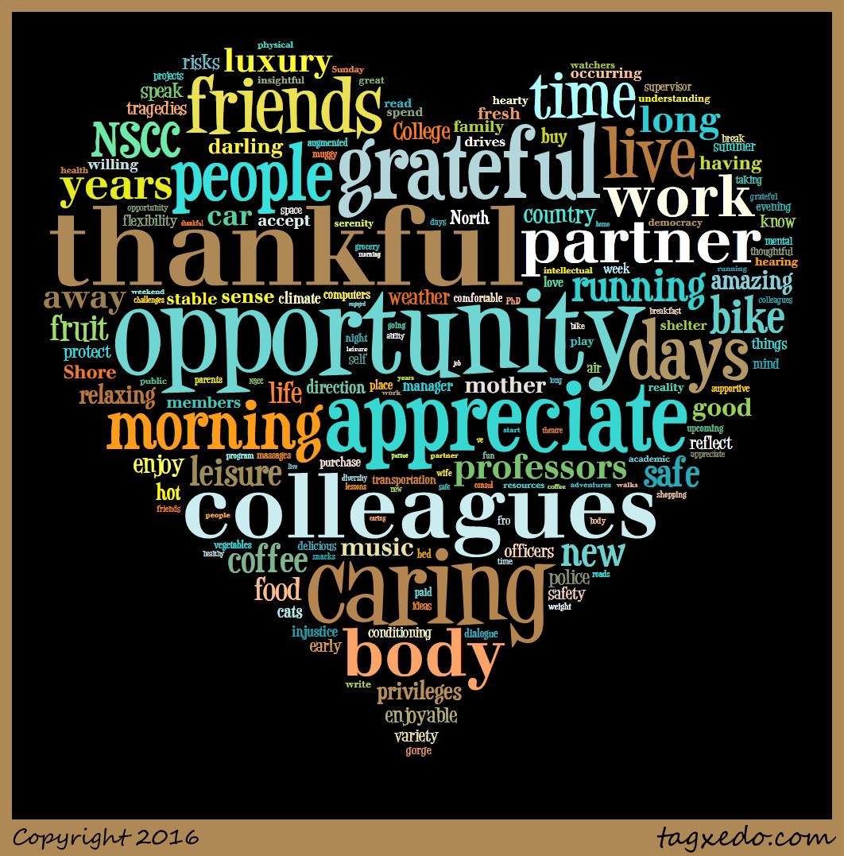
What do You Focus on?
“Between stimulus and response there is a space. In that space is our power to choose our response. In our response lies our growth and our freedom.”
Viktor E. Frankl

Slide 4
Thinking Error Definitions
All or Nothing Thinking: Absolutes; black and white; always or never; I can’t see someone else’s perspective
Over Generalization: A negative event as a pattern of defeat
Discounting the Positive: Positive perspective is less then or minimized; Strict focus on the negative
Mental/Logical Filter: Using only one or the other (frontal lobes) to make decisions. Wise-mind is using both
Emotional Filter: Using only one or the other (frontal lobes) to make decisions. Wise-mind is using both
Jumping to Conclusions: A. Mind-reading-when facts are not present, or emotion is assumed B. Fortune-telling-predict the future or tell someone how to they are going to feel.
Magnification or Minimization: blowing things out of proportion or shrink the positive
Should/Shame Statements: Should’s; musts; criticize self or others to add shame of worthlessness. Change to could
Labeling or Mislabeling: Labeling a group or shaming yourself without known facts or awareness
Personalization or Blame: Taking on someone else’s problems when it’s out of your control; Deny the role you played

Slide 5
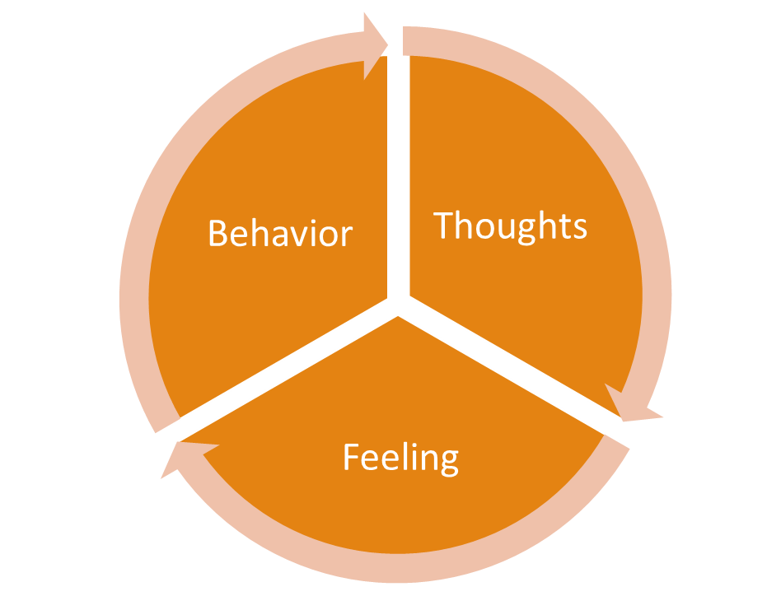
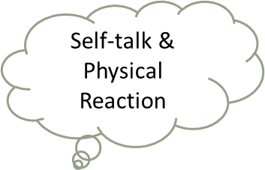
Thought Process
FRONTAL LOBE- 2 Parts
SELF-TALK
Physical Response
Reward System
Reasoning
Organizing
Emotions/Logic

Slide 6
Facts About the Brain
Right Side
Left Side
Store’s Autobiographical Memory
Hold’s Raw emotional needs and feelings
Personal Reflection
Looks Inward to Self and Others
Non-Verbal Connection with Others
Creative Imagination
Language and Logic
Linear Thinking
“Approach State”
Looks Outward to the World
Social Display of Rules
Box of Meaning

Slide 7
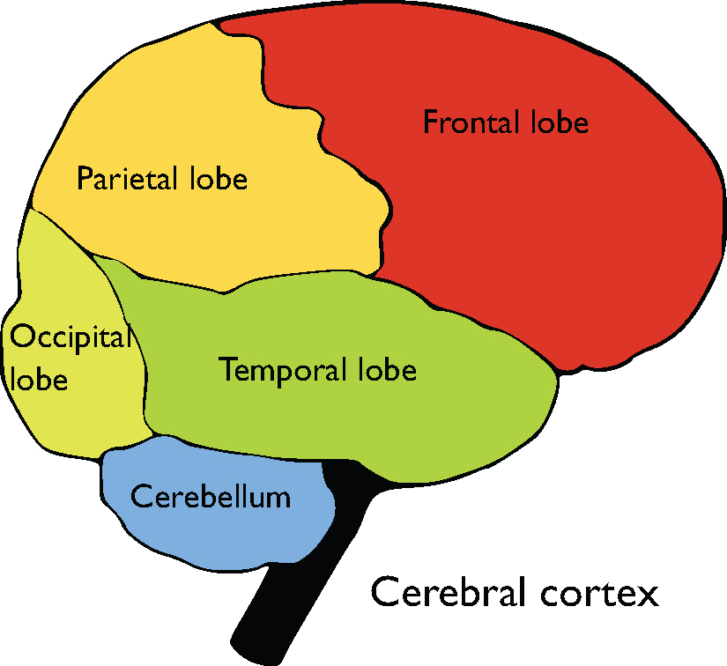
Self-Talk the Frontal Lobe
Thinking Errors are not FACTS
Ask yourself-Is this true?
How does this make me feel?
What if I did not hold this belief?
*4 main reasons why we do not self-talk
1.FFF 2.Burnout 3.Impairment 4.Mental Disorder

Slide 8
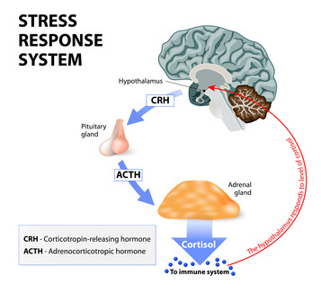
Behavior Process
Fight Flight Freeze→ Mid Brain
Aggressive (fight)-Direct w/ Disrespect
Passive Aggressive (flight)-Say Yes when you mean No
Passive (freeze)-Everyone else is right
Assertive- Direct w/Respect
I feel/ I need/ I am willing

Slide 9
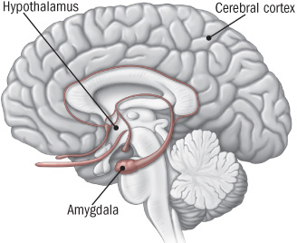
What is going on…Brain Cycle
MID BRAIN- Past
Fight, Flight, Freeze
Flooding
Flashbacks
Rumination
Thinking Error Stories
Intense Fear
Chemicals/Genes CHANGE
Survival Stress Response

Slide 10
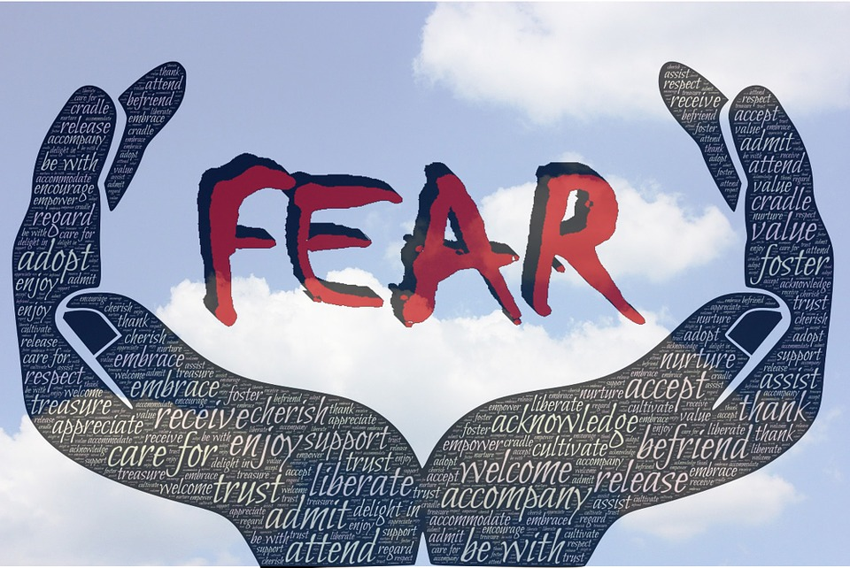
Don’t Let Chemicals Hijack the Brain
Two Chemicals- Love or Fear

Slide 11
Hugo Lovheim created- cube of emotion correlated brain chemicals with emotions
https://blog.daftmobile.com/short-story-about-the-brain-chemicals-and-how-they-affect-players-d078792139ec

Slide 12
Neurotransmitters
These chemicals transmit nerve impulses and act as communicators to the body and brain. They are the runners that race to every organ and cell through emotional chemicals for our desires, memories, intuitions, and dreams. Which gives us a mind and body response.
For example fear will activate our Fight or Flight or Freeze mid brain and may produce tears. “Crying literally serves to relieve the stress that is caused a continual chemical emission that eventually leads to illness….(yet) emotions help us survive.”
(Truman) Feelings Buried Alive Never Die pg. 280

Slide 13
How is shame a defense mechanism of our Fight Flight or Freeze?
Brain
Thought
Physical and Self-Talk
Feeling
Behavior
Defense Mechanism FFF
Our fear response brain is the body's automatic
built-in system designed to protect us from
threat or danger and even death.
85% of men and women interviewed for shame research could recall a school incident of being shamed from their childhood (RS pg. 83)
Over 50% of participants experienced shame in their faith history, found resilience in healing through spirituality (RS pg. 82)

Slide 14
Defense Mechanism
Denial -Individual pretends it didn’t happen and might fool him/herself into thinking it did and then denies it ever happened.
Shifting Focus -Individual turn peoples minds and attention onto something else, and distant them from the real issue.
Blaming Others or Victim- Individual blames the problem on his own behavior, someone else, or the victim. The victim brought it on himself or herself.
Intellectualization-Individual tries to use ideas or intellect to sidetrack from the issue by finding an excuse or explanations.
Playing Dumb- Individual acts or pretends he/she didn’t it was wrong or against the rules.
Rationalization -Individual finds excuses and explanations for behavior.
Justification -Individual finds reasons to explain “correctness” and that it was okay for the behavior.
Dismissal -Individual disregards, ignore, or brushes it under the rug others feelings or their behavior.
Projection- Individual projects traits in oneself and attributed to others or a group.
Avoidance -Individual avoids thinking about emotionally difficult subjects, as they feel overwhelmed.
Comparing- Individual may defend the ego by comparing themselves to those worse off. Similarly, we may see similarities between ourselves and others in a better position to improve our self image
Displacement- Individual takes feelings that belong in one situation and displace them on someone or something
Narcissistic Trait Thinking Errors:
Entitled -Individual feels as though they deserve good things, even though they have not worked for them.
Grandiose -Individual feels as though he/she is better then others and should be looked up to.
Revenge-Individual feels as though he/she has been wronged and is entitled to get revenge.
One Upsmanship -Individual feels he/she has to do better than everyone else, to show he/she is the best.

Slide 15
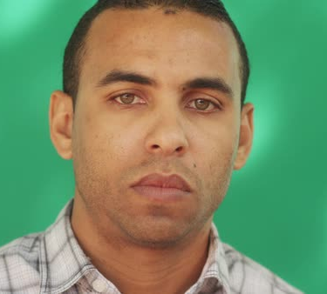
Automatic Negative Thoughts (ANTs)
“I have to worry about it or something bad might happen”
“What’s wrong with me?”
“I am such an idiot.”
We all have them……
“If I look nervous, they won’t hire me.”
“If that happens, I won’t be able to handle it.”

Slide 16
ANTS
Triger
Automatic Negative thought
New Thought Process/Story
I made a mistake at work. I am probably going to get fired. I am no good at my job.
I messed up, but mistakes happen. I’m going to work through this as I have before.

Slide 17
When identifying an ANT, remember to…
…phrase the thoughts in the form of a statement, and avoid “what if’s” and questions. For example, if the thought is “What if I lose my job?” it would be better to phrase it “I will lose my job.”
…be specific about the fear. It is better to break more general thoughts up into more manageable pieces. If the thought is “I feel like something bad is going to happen,” make a list of the specific things that you worry might happen. Write down the first ANTs that come into your head. You might use the “Thought Cascade” approach to learn more about what is scary to you.
…notice the thoughts that seem to come up often or are more impairing than others. You may want to begin with these when you start working on the thoughts.

Slide 18
Negative Cognitions to Positive Cognitions
Responsibility/Defectiveness
I’m not good enough/ I am good enough/fine as I am
I don’t deserve love /I deserve love; I can have love
I am a bad person/ I am a good (loving) person
I am incompetent /I am competent
I am worthless/inadequate I am worthy; I am worthwhile
I am shameful/ I am honorable
I am not lovable/ I am lovable
I deserve only bad things/ I deserve good things
I am permanently damaged/ I am/can be healthy
I am ugly/my body is hateful/ I am fine/attractive/
I do not deserve ____/I can have/deserve ____
I am stupid/not smart enough/ I am intelligent/able to learn
I am insignificant/unimportant/ I am significant/important
I am a disappointment/ I am OK just the way I am
I deserve to die/ I deserve to live
I deserve to be miserable/ I deserve to be happy
I am different/don’t belong/ I am OK as I am
I have to be perfect (out of inadequacy)/ I am fine the way I am
Responsibility: Action
I should have done something* I did the best I could
I did something wrong* I learned/can learn from it
I should have known better* I do the best I can/I can learn
I am inadequate/weak /I am adequate/strong
*What does this say about you? (e.g., I am shameful/I am stupid/I am a bad person)
Safety/Vulnerability
I cannot trust anyone I can choose whom to trust
I cannot protect myself I can learn to protect myself
I am in danger It’s over; I am safe now
I am not safe I am safe now
I am going to die I am safe now
It’s not OK (safe) to feel/show my emotions I can safely feel/show my emotions
Power/Control/Choice
I am not in control I am now in control
I am powerless/helpless I now have choices
I cannot get what I want I can get what I want
I cannot stand up for myself I can make my needs known

Slide 19
Manage the Root Issues/Seeds
Leafy Issue
Failed relationships, Financial Issues,
Junk Values, Addiction, Thinking Errors
Trunk
2nd Emotion
Hurt, Inadequate, Raw, Stuck,
Fear, Anger, Betrayed, Hopeless
Root Issue
Loss, Grief, Trauma (developmental, relational, etc.), Self-Concept, Abandonment, Shame, Denial, Metal Health, Chronic Health

Slide 20
Coping Skills Check List
Mindfulness Focus on the Present
Self-talk
Relaxation Techniques (breath)
Healthy Quick Stress Relievers (call)
Time–Out 10 minutes to 24 hours
Humor
Thought Stopping
Conflict Negotiation
Problem Solving
Challenge Negative Thinking
Choosing Assertiveness vs. Aggression
Leave Shame and Judgement
Balance –Physical, Mental, Social, Emotional/Spiritual
Mindfulness
Logic and Emotion Together (wise-mind)
Create a Mental “Safe Space”
Reduce Caffeine and/or Alcohol/Drug Use
Connection
Reduce Thinking Errors
Clean up Your Environment
Create a Reward System
Mini Vacations
Burnout Prevention

Slide 21
References
Brown, B. (2010). The power of vulnerability. TED Talk.
Brown (2010). The Gifts of Imperfection: Let Go of Who You Think You’re Supposed to Be and Embrace Who You Are
Brown (2012). Listening to Shame. TED Talk
Brown (2012). Daring Greatly: How the Courage to Be Vulnerable Transforms the Way We Live, Love, Parent, and Lead.
Brown (2012). The Gifts of Imperfect Parenting. Audible
Frankl, V. E. (1984). Man's search for meaning: An introduction to logotherapy. New York: Simon & Schuster.
Goleman (1995). Emotional intelligence: Why it can matter more than IQ. New York: Bantam Books.
Goleman (2006). Social Intelligence: The New Science of Social Relationships. Bantam Books.
Hari, J. (2018). Lost connections: Uncovering the real causes of depression-- and the unexpected solutions.
Maslash, C. & M. P. Letter, (2015) It’s Time to Take Action on Burnout. Burnout Research 2, IV-V
Patterson, Kerry. (Eds.) (2012) Crucial conversations: tools for talking when stakes are high New York : McGraw-Hill,
Truman (2003). Feelings buried alive never die. Olympus Distributing
https://positivepsychology.com/emotional-intelligence-ted-talks

