Slide 1
CARYL WARD LCMHC, CFLE 801.999.0179 cell
BFF Your Sleep and Brain
And Why our sleep requires attention

Slide 2
BFF Your Sleep and Brain
BFF your Brain with Clarity, Connection, Control
Breath, Focus, Frame your Sleep and Brain
BFF your Breath and be Focused in the Present
BFF Framing is the way that you view the world. This is called cognitive bias, which essentially means that you react differently to information based on whether it is presented to you in a positive or negative way. No matter which way you see things, it directly impacts the decisions that you make. Look at the positive!
You Have the POWER

Slide 3
Physical Balance #1
Emotion&
Spiritual
Emotional Intelligent
Physical
Sleep
Mental
Brain power
Social
Family
Diet
Exercise
New tasks
Friends
Community
Grounded
Connection
Judgment

Slide 4
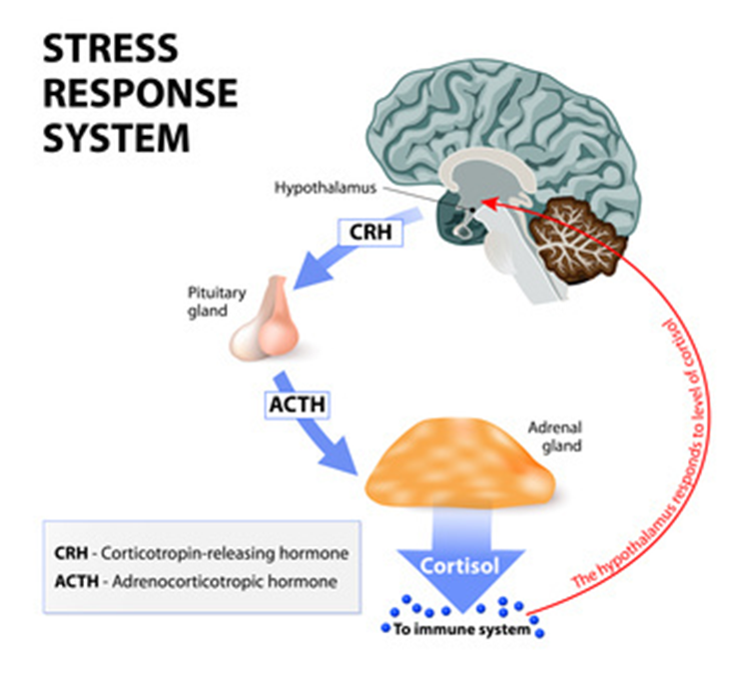
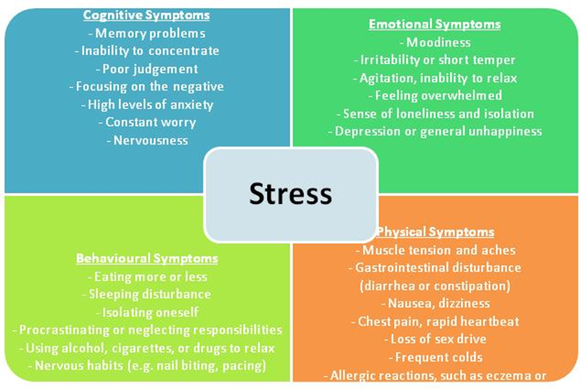
Swimming in Cortisol?

Slide 5
Stress and Burnout
Cognitive
Attention & processing reduces, short-term memory problems, judgment impaired, racing thoughts, ridged thinking, focus on the negative
Emotional
Increased irritability, frustration, impatience, depression, anxiety, hopelessness, confusion, numbness
Behavioral
Increased bad/nervous habits, sleep disturbances, impaired listening skills, withdrawal, aggression
Physiological
Rapid heartbeat, increased fatigue, illnesses, stomach problems, nausea, dizziness, aches, decreased libido, headaches, difficulty breathing, sweating
Honeymoon Stage
Onset of Stress
Chronic Stress
Burnout
Habitual Burnout

Slide 6
General Sleep Stats
Children and Teens
Adults “Public Problem”
Sleep deprivation can cause you to lose 11 days of productivity
1/3 of teens say that stress causes them to lie awake
Teens that sleep 34 mins longer have 4.5% higher test scores
For every hour of sleep lost, sad, hopeless, and suicide increases by 38%
Putting down phones can help you sleep 21 mins longer
Blue light exposure reduces sleep by 16 mins. and cause 7.6 more sleep disruptions
https://casper.com/blog/sleep-statistics/
68% of Americans struggle with sleep once a week
36.5% receive less than 7 hours, avg is 6.8
41% use over the counter sleep aids
1 in 10 put sleep at the top of the list over exercise, work, and social
70 Types of sleep disorders
Less than 7 hours of sleep, you are 4.2x more likely to get sick
Each child in the house increases mother’s insufficient sleep by 46%

Slide 7
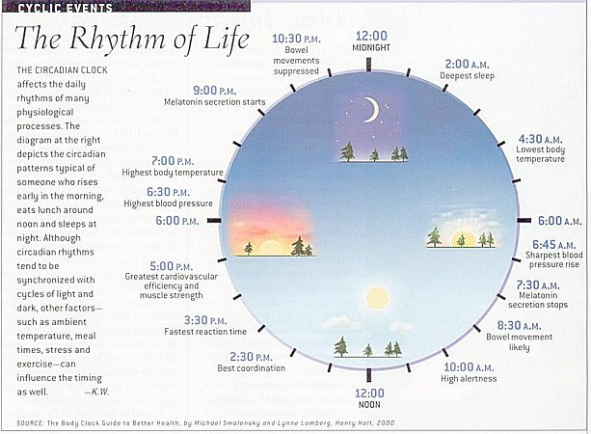
Circadian Rhythm
83% of middle school and 93% of high school kids start school before 8:30 am
Melatonin hormone does not generally stop releasing till 7:30 am
Go with the Seasons
Reduce stress
This Photo by Unknown Author is licensed under CC BY-NC

Slide 8
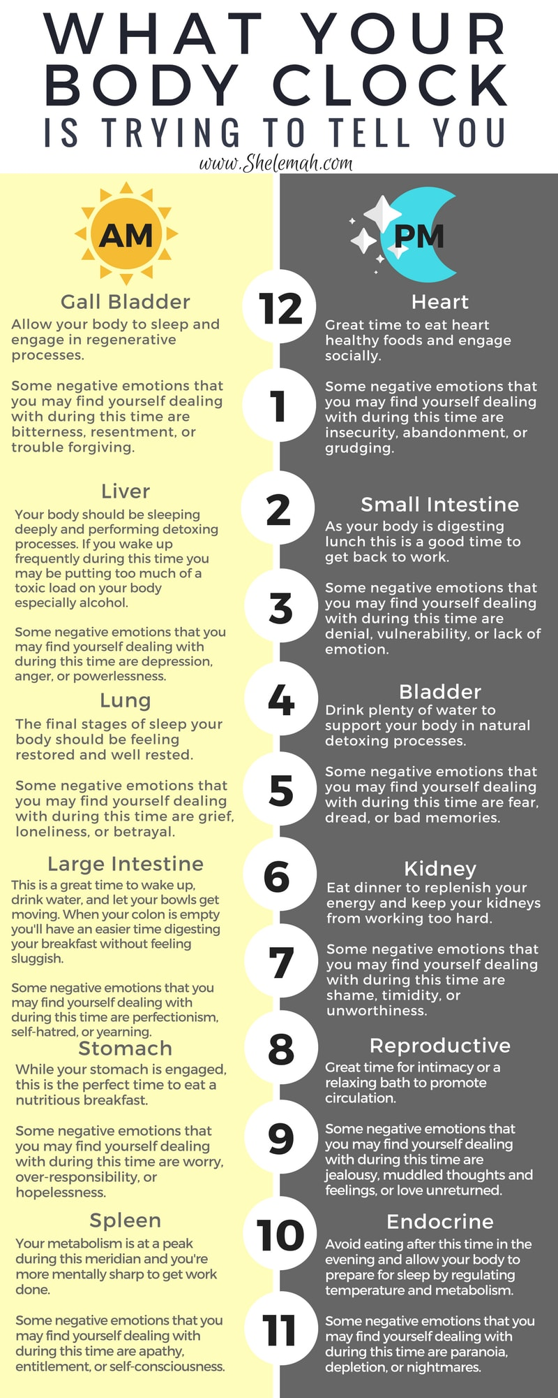
Time & Vision
Yellow Light 1-10 mins first thing in the morning
Eye Lids are Thin
Early in the day- eat, exercise, light
No Blue light at night
Soft Orange Light
Salt Lamp
Relax Body

Slide 9
REM Sleep
Rapid Eye Movement (REM) Sleep: You generally enter REM sleep about 90 minutes after initially falling asleep, and each REM stage can last up to an hour. An average adult has five to six REM cycles each night. During this final phase of sleep, your brain becomes more active. This is when most dreaming occurs, your eyes jerk quickly in different directions, heart rate and blood pressure increase, and breathing becomes fast, irregular, and shallow. REM sleep plays an important role in learning and memory function, since this is when your brain consolidates and processes information from the day before so that it can be stored in your long-term memory.
https://www.sleep.org/

Slide 10
NREM Sleep
The period of NREM sleep is made up of stages 1 to 4. Each stage can last from 5 to 15 minutes. Stages 2 and 3 repeat backwards before REM sleep is attained.
During NREM sleep, the body repairs and regenerates tissues, builds bone and muscle, and appears to strengthen the immune system. As you get older, you get less NREM sleep. People under age 30 have about two hours of restorative sleep every night, while those over 65 might get only 30 minutes.

Slide 11
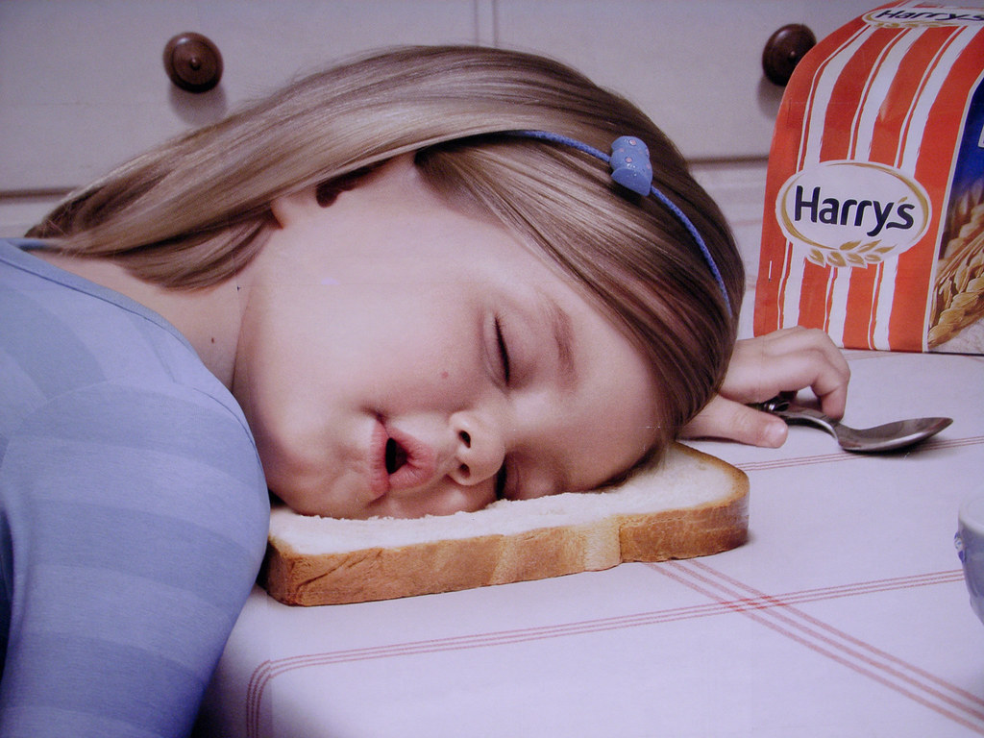
How Much Sleep is Needed
Benefits of REM sleep: better brain development, boost in memory, concentration, learning, mood, creativity, better immune system, less depression, more growth hormones, improved blood supply to muscles, better health overall, reduces heart disease and strokes and have a higher educational level.
Newborns 14-17 hours
Infants 12-15 hours
School Aged 9-11 hours
Teens 8-10 hours
Adults 7-9 hours
65 + 7-9 hours
American average- 7 hours with 35% report “poor” sleep quality. 7/10 high School age don’t get enough sleep.

Slide 12
Supplements for Reducing Symptoms of Anxiety and Improving Sleep
Magnesium Glycinate (400 mg 2x a day)
Magnesium Citrate (400 mg) /Calm Power
D3 10,000 IUS daily Adults/2,000 IUS Kids
Zinc
Omega 3 EPA (Vit A)
SAM-e (400-1600 mg) (for depression also)
Lavender (antiseptic function)
Chamomile (200-1500 mg)
Milk Thistle (anti-depressant/OCD)
B-Vitamins
Folic Acid
Ashwagandha
Kava Kava (works through Gaba)
Amino Acids(calming neurotransmitter)
5 HTP
L-Tyrosine
L-Theanine (100 mg 1-4 caps for sleep)
Gaba
Triphala (gut health)
Tryptophan

Slide 13
Melatonin 101
Melatonin sales increased 500% from 62M in 2003 to 378M in 2014
Out of 31 labels studied, 71% were not within 10% of the listed dosage
Between 0.5 mg to 5 mg once daily is the normal doze for adults
“Oral doses (1 to 5 mg), which are now widely available in drugstores and food stores, result in serum melatonin concentrations that are 10 to 100 times higher than the usual night time peak within one hour after ingestion, followed by a decline to base-line values in four to eight hours.”
YET 3 mgs is 20-100x what our bodies produce
Children produce 3x the amount then adults .03-.05mg for children (Studies have show improvement in autism)
Use in droplet form for swing/graveyard shifts or when traveling and improves Dementia
Your body may form adjustments that will cause withdrawals with “fake” sleep
Grigg-Damberger (2017)/Erland (2017) https://www.sleepfoundation.org/how-sleep-works/sleep-facts-statistics

Slide 14
Sleep Deprived Consequences!
Disrupted rhythms can increase the risk for substance abuse and relapse
Disturbed circadian rhythms has been associated with a variety of mental and physical disorders
Light kills Melatonin
Good sleep can maximize problem-solving skills and enhance memory. Poor sleep has been shown to impair brain function and burnout.
Less than 7–8 hours per night is linked to an increased risk of heart disease, stroke, cancer, depression, inflammatory bowel diseases, and lowers immune system, diabetes, and many more.
Burnout

Slide 15
You Have the Power!
You Have the Power to Unplug!
Family Boundaries and Limits
Take Back your POWER Rooms (Kitchen, Bathroom, Bedroom)
No Power after 8pm, No Fuel (carbs), and No Exercise
Blue Light Blocker Glasses at Night
During a 20 min workout GABA is released and can improve your mood for 12 hours (Thomas,2009/pg. 102, Axe).

Slide 16
Mindfulness Coping
The focus is on what’s right in front of you, turning to your physical sensations with full awareness. Letting go of thoughts of the past or future without judgment.
2-10 Minute Distraction to Break the Urge
Pause throughout the day with present mindfulness, walking, eating, imagery, or body scan
Ways to Calm the Autonomic (Sympathetic) Nervous System
Four Square Breathing
Trace, Color or Record Feelings
Focus Point (hold a pen 6 inches from eyes)
Call Someone
Room Scan and Use 5 senses (point out what you see etc.)
Worry Bag (to take with you places)
http://www.freemindfulness.org/download
http://www.livingwell.org.au/mindfulness-exercises-3/8-mindfulness-of-thoughts/

Slide 17
Fun Sleep Tips
Heating cold feet causes vasodilation—dilation of the blood vessels—which may tell the brain that it is bedtime. After the blood vessels open in the hands and feet, heat is redistributed throughout the body to prepare for sleep. In fact, some research has shown that the more vasodilation in the hands and feet, the less time it takes to fall asleep.
A spoonful of almond butter is a good source of magnesium. Having low magnesium levels puts you at a higher risk for insomnia, so it’s important to get enough of it. Also, Epson Salt bath does the same.
Lavender oil has been proven to alleviate insomnia, anxiety and depression when taken in a 80 mg orally, and has shown it reduces PTSD symptoms by a third (2013, Kasper). For sleep 2-3 drops of oil on temples or neck (pg. 96, Axe)
The Keto diet has shown to be the best anti-inflammatory diet to correct sleep issues, mental health, and overall brain health.
78% of people feel excited when they have clean sheet (sleep foundation, 2020).
https://www.sleep.org/

Slide 18
Bedtime Routine Tips
Sleep Hygiene Routine
Stretch
Electronics/Lights off
1-2 hours before bedtime
Blue Blocker Glasses
Relaxation Techniques
Hyper-sleep (YouTube)/Mindful
Avoid Caffeine
Reduce or Avoid Naps
20 Minute Rule
Get out of your bed
Read
Journal
Mind dump worries/emotions/gratitude
Lower Social Interactions
Day Time/ Auto Piolet
Bedroom Cool
Bilateral Tapping
Each hemisphere of brain is used and begins calming the FFF brain
Circadian Rhythm

Slide 19
Morning
The best morning routine is one that is tailored to you
Wake up at same time
Morning routine
Avoid upsetting news and work emails
Read or listen to something motivational
Podcast, music, mediation
Exercise and hydrate
How to make this a great day
Journal/Planner
Get dressed for the day

Slide 20
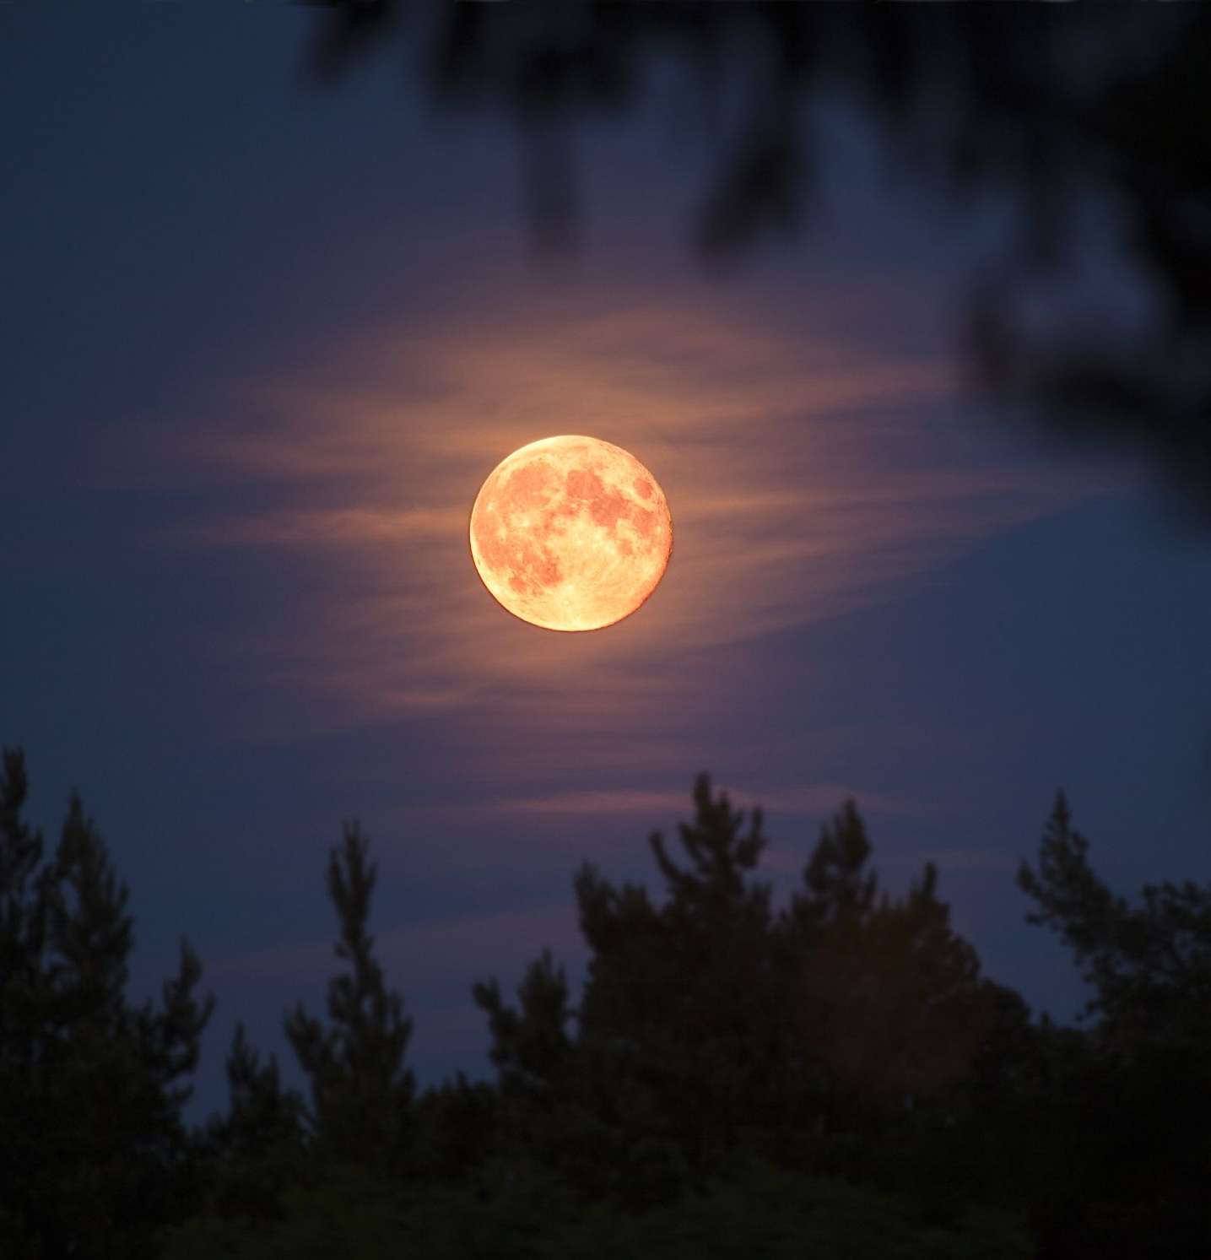
Questions to End the Day
End of the day
What went well today?
What are three things that I am grateful for?
What random act of kindness was I able to do do today?
Who did I connect with today?
How did I reduce stress and tension within myself and the family unit?
Are there any changes we need to make?

Slide 21
References
Axe (2019). Keto Diet: Your 30-Day Plan to Lose Weight, Balance Hormones, Boost Brain Health, and Reverse Disease
Cline, Fay (2016). Parenting With Love And Logic
Gottman (1997). Raising An Emotionally Intelligent Child
Hari, J. (2018). Lost connections: Uncovering the real causes of depression-- and the unexpected solutions.
Maslash, C. & M. P. Letter, (2015) It’s Time to Take Action on Burnout. Burnout Research 2, IV-V
https://casper.com/blog/sleep-statistics/
https://draxe.com/nutrition/guide-to-keto-diet-for-beginners/
https://www.ncbi.nlm.nih.gov/pmc/articles/PMC1855314/
https://www.sleepfoundation.org/articles/why-your-child-needs-sleep-schedule-throughout-summer
https://www.sleepfoundation.org/how-sleep-works/sleep-facts-statistics
https://www.youtube.com/watch?v=Kvs-_22lwjA (Dr. Wayne 5 mins before bed positive affirmations)
https://www.ncbi.nlm.nih.gov/pmc/articles/PMC6707128/
https://youtu.be/Ft9N2-CEPzc Andrew Huberman
Vitaterna, M. H., Takahashi, J. S., & Turek, F. W. (2001). Overview of circadian rhythms. Alcohol research & health : the journal of the National Institute on Alcohol Abuse and Alcoholism, 25(2), 85–93.
Winter, C. (2016) The Sleep Solution: Why Your Sleep Is Broken and How to Fix It.

