Slide 1
Time, Values, and Family CARYL WARD LCMHC, CFLE carylscounseling@gmail.com 801.999.0179 cell

Slide 2
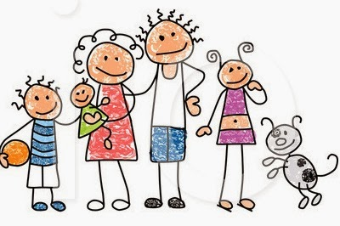
Highly Effective Families
What single thing that we should be doing regularly to make a big change in your life lines up with your values?
Family Connection
Hot topic time-once a week for 30 minutes
Family mission statement and top 5 values
Family one on one boss time (each child)
Mandatory family fun time
Family dinner
Clean up an environment
Balance

Slide 3
Time- We all Have 24 hours in a Day

Slide 4
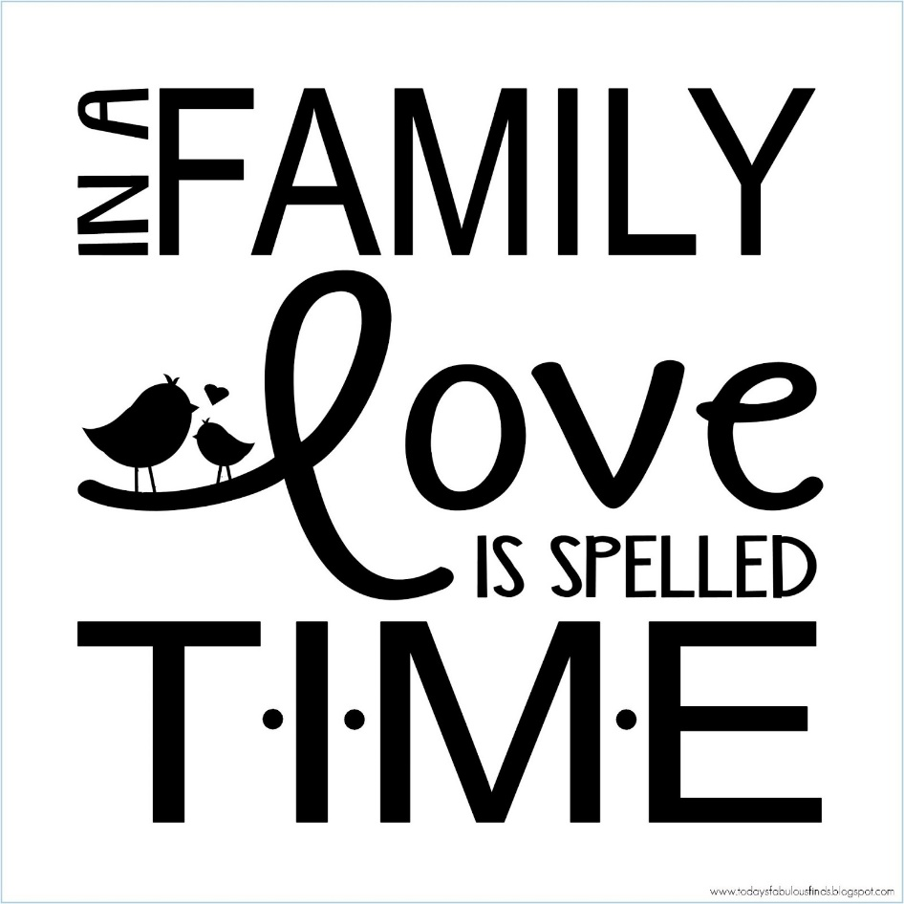
Covey’s Habits
https://www.youtube.com/watch?v=q3ozkMuuDo4

Slide 5
Clock and the Compass
Clock- Manage Time
Compass-Vision
Commitments
Appointments
Schedules
Goals
Activates
Values
Principles
Mission
Direction
Control/Power
Wake up calls—when what we do doesn’t contribute to what is most important.
(Covey 94, pg. 20)

Slide 6
Three Generations of Time Management
To close the gap between the clock and the compass we turn to time management
1st generation- Reminders
Make lists, task reminders, keep track
2nd generation- Planning
Goal setting, identifying deadlines, responsibilities
3rd generation- Prioritizing and Controlling
You have clarified your values and boundaries

Slide 7
4 Quadrants or AB&C
(Covey)

Slide 8
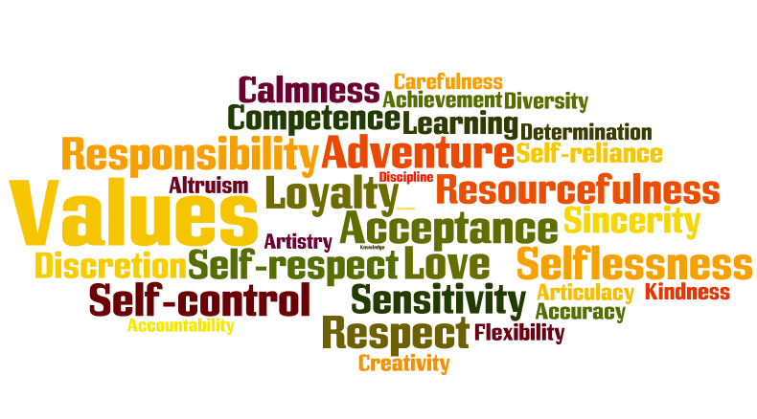
Time Management
Time
Energy
Money

Slide 9
Higher Purpose in Values

Slide 10
Boundaries around your VALUES Kids are hard wired to push boundaries, parents job is to hold them, not to be liked
Guardian
Protect, preserve safety to grow in a healthy environment (something to hold on to)
Manager
Expectations are met by correcting, teaching, enforcing and building skills
Source
Basic needs, support, and wisdom

Slide 11
Energy Starts with Self-Discipline
5 R’s
Routine- Fixed Program
Responsibility-Having a Duty
Reassurance-Fears are Unseen and Real
Reward-Schedule it!
Resiliency
Takes TIME
6 Stages of Change
Caryl Ward LCMHC, CFLE ©

Slide 12
The Five R’s Tips
Routine- Find new traditions, play, and creative TIME together
Responsibly- Love & Logic = Choices = Power = Thinking Words not Fighting Words
Reassurance- Model emotions by validation and empathy
Reward- Set up new Reward System/Distraction
Resilience- Instill HOPE by telling the story

Slide 13
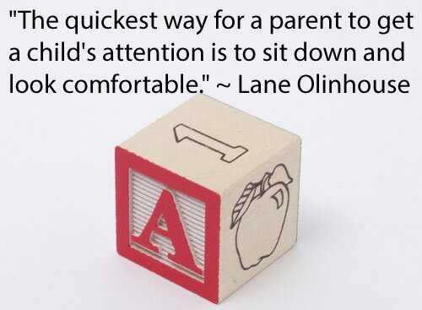
Mental Balance
Creative Play Activates
Limit Screen Time
Good Distractions 10 minutes-1 hour
vs. Avoidances-2 hours plus
Timer as the BOSS for Homework
Create a Mental “Safe Space”
Need—Hula-Hoop, Desk, Stress Bag, Signs (Mommy’s on a call),
five senses bag

Slide 14
Couple/Family Hot Topic Time
*Set a time to bring up Hot Topics that have been written down in a notebook or jar. 1 x a week for 30 min. Make prior safety rules.

Slide 15
Energy Clean up the ENVIORMENT
Self/Physical/Emotional
Spiritual
Relationships
Work/
Network
Financial
Nature
Home

Slide 16
Tips and Re-Cap
Prioritize the task to A,B or C
Eliminate avoidant behavior
Eliminate perfectionism
Do a 10 minute distraction between tasks
Schedule rewards
Time it
Set deadlines
Don’t multitask
Set routines
Schedule it or it won’t happen
Track your balance
Planner it
Plan ahead
Clean up your environment
Know your values and higher purpose
Have boundaries around your time
Make time your boss
Do the best you can!

Slide 17
Reference
Brown (2010). The Gifts of Imperfection: Let Go of Who You Think You’re Supposed to Be and Embrace Who You Are
Covey, S. R. (1997). The 7 habits of highly effective families: building a beautiful family culture in a turbulent world. New York: Golden Books.
Covey, S. R. (2004). The 7 habits of highly effective people: Restoring the character ethic. New York: Free Press.
Covey, S. R., Merrill, A. R., & Merrill, R. R. (1994). First things first: To live, to love, to learn, to leave a legacy.
https://www.youtube.com/watch?v=Z459cW8C3i0
Peck, M. S. (1978). The road less traveled: A new psychology of love, traditional values, and spiritual growth. New York: Simon and Schuster.
Zadra, Kobi (2007) 5: Where will you be five years from today?
https://www.ted.com/talks/nora_mcinerny_we_don_t_move_on_from_grief_we_move_forward_with_it?language=en

