Slide 1
Anxiety 101:How to Reduce the Anxious Brain CARYL ANN DUVALL LCMHC CFLE carylscounseling@gmail.com 801.999.0179 cell

Slide 2
Unknown or Unseen Trauma’s
Traumatic Events
Acute Stress
One Month, Short Term
Adjustment
Six Months
Post Traumatic
Three-Six Months Plus, Long Term
Trauma Emotions of Loss, Grief, Powerless
Unseen vs. Seen

Slide 3
Fear of the Future…?
Worry
Anxiety
Normal
Mild Distress
Temporary
Verbal
Thoughts/Mind
A Given Situation with Solution
Controllable
Severe Emotional Distress/Pain
Linger
Physical Body
Mental Imagery
Less Problem Solving
Negative Mental Imagery
Not Controllable
Blocking Progress
Perfectionism
Personal Functioning is Impaired
Ruminate (Playing the Scene Over n Over)

Slide 4
Anxiety Disorders
Anxiety disorders manifest in different ways, and are often diagnostically distinct
Generalized Anxiety Disorder (GAD) is a chronic state of severe worry and tension.
Panic disorder (PD) refers to sudden and repeated panic attacks—episodes of intense fear and discomfort that peak within a few minutes without a trigger.
Agoraphobia (AG) is fear of feeling trapped and avoid places or situations that might cause you to panic and make you feel helpless or embarrassed.
Specific Phobia (SP) is fear related to exposure to specific objects or situation and avoidance of it.

Slide 5
Additional Worry
Obsessive-compulsive disorder (OCD) is marked by intrusive thoughts or compulsions to carry out specific behaviors for more than one hour a day (hand washing).
PTSD disorder may develop after experiencing or witnessing a traumatic event.
Dissociative Disorders involve problems with memory, identity, emotion, perception, behavior and sense of self.
Major Depressive Disorder (MDD) irritable mood or a loss of interest or pleasure in daily activities for more than two weeks.
ADHD chronic condition marked by persistent inattention, hyperactivity, and sometimes impulsivity in all areas of environment.

Slide 6
Vagus Nerve
The vagal circuitry narrows our focus and prepares us to fight or flee or freeze—called the stress response brain.
If the danger is so overwhelming that there’s no escape or there’s a feeling of being trapped, a third circuit of vagal operations engineers a shutdown. In this out-of-focus, numb state, social contact becomes an intrusion and is aversive.
The bodily responses are not voluntary, and often people are not aware of what triggered them, although they are likely aware that their heart is pounding or their body is trembling.
https://www.psychologytoday.com/us/basics/vagus-nerve

Slide 7
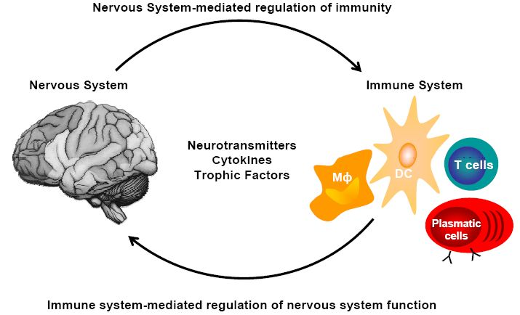
Watch for..
Excessive crying or irritation in younger children
Returning to behaviors they have outgrown (for example, toileting accidents or bedwetting)
Excessive worry or sadness
Unhealthy eating or sleeping habits
Irritability and “acting out” behaviors in teens
Poor school performance or avoiding school
Difficulty with attention and concentration
Avoidance of activities enjoyed in the past
Unexplained headaches or body pain
Use of alcohol, tobacco, or other drugs

Slide 8
Tips and Coping (Stopping the Bleeding)
Failure Thoughts
Under Function
FFF-Stress Brain
Low Self Esteem
Set Backs

Slide 9
Mindfulness

Slide 10
Mindfulness Coping
The focus on what’s right in front of you, turning to your physical sensations with full awareness. Letting go of thoughts of the past or future without judgment.
2-10 Minute Distraction to Break the Urge
Pause throughout the day with present mindfulness, walking, eating, imagery, or body scan
Ways to Calm the Autonomic (Sympathetic) Nervous System
Four Square Breathing
Trace or Color or Record Feelings
Focus Point (hold a pen 6 inches from eyes)
Call Someone
Room Scan and Use 5 senses (point out what you see etc.)
Worry Bag (to take with you places)
http://www.freemindfulness.org/download
http://www.livingwell.org.au/mindfulness-exercises-3/8-mindfulness-of-thoughts/

Slide 11
5 Steps of Emotional Coaching
Become Aware and Intelligent of ALL Emotions
Recognize an Opportunity for Teaching and Intimacy
Listen, Validate, and Reflect
Coach the Child to Label How They Feel
Accept -communicate your understanding and acceptance of the emotion through empathy
Set Limits and Problem Solve Accordingly to your Family Values
(Gottman 1997)

Slide 12
Medications
Selective serotonin reuptake inhibitors (SSRIs) are a class of drugs that are typically used as antidepressants in the treatment of major depressive disorder and anxiety disorders.
SSRIs function by increasing the extracellular level of the neurotransmitter serotonin by limiting its reabsorption (reuptake) into the presynaptic cell, increasing the level of serotonin in the synaptic cleft available to bind to the postsynaptic receptor.
They have varying degrees of selectivity for the other monoamine transporters, with pure SSRIs having only weak affinity for the norepinephrine and dopamine transporters.
Studies question the efficacy of treating anxiety with an antidepressant. Doctors often prescribe antidepressants, such as paroxetine (Paxil), fluvoxamine (Luvox), or sertraline (Zoloft), for the treatment of anxiety
SSRIs can be helpful for depression, panic disorder, social anxiety, obsessive compulsive disorder, generalized anxiety and PTSD
https://www.anxieties.com/156/selective-serotonin-reuptake-inhibitors-ssris

Slide 13
Signs…To Body and Mind
Cognitive
Attention & processing reduces, short-term memory problems, judgment impaired, racing thoughts, ridged thinking, focus on the negative
Emotional
Increased irritability, frustration, impatience, depression, anxiety, hopelessness, confusion, numbness
Behavioral
Increased bad/nervous habits, sleep disturbances, impaired listening skills, withdrawal, aggression
Physiological
Rapid heartbeat, increased fatigue, illnesses, stomach problems, nausea, dizziness, aches, decreased libido, headaches, difficulty breathing, sweating

Slide 14
References
Gottman (1997) Raising An Emotionally Intelligent Child
https://www.ted.com/talks/guy_winch_why_we_all_need_to_practice_emotional_first_aid#t-114681
https://www.psychologytoday.com/us/basics/vagus-nerve
https://www.cdc.gov/coronavirus/2019-ncov/daily-life-coping/managing-stress-anxiety.html?CDC_AA_refVal=https%3A%2F%2Fwww.cdc.gov%2Fcoronavirus%2F2019-ncov%2Fprepare%2Fmanaging-stress-anxiety.html

