Slide 1
Thinking Errors 101 How We Think, Feel, and Behave CARYL ANN WARD LCMHC, CFLE 801.999.0179 carylscounseling@gmail.com

Slide 2
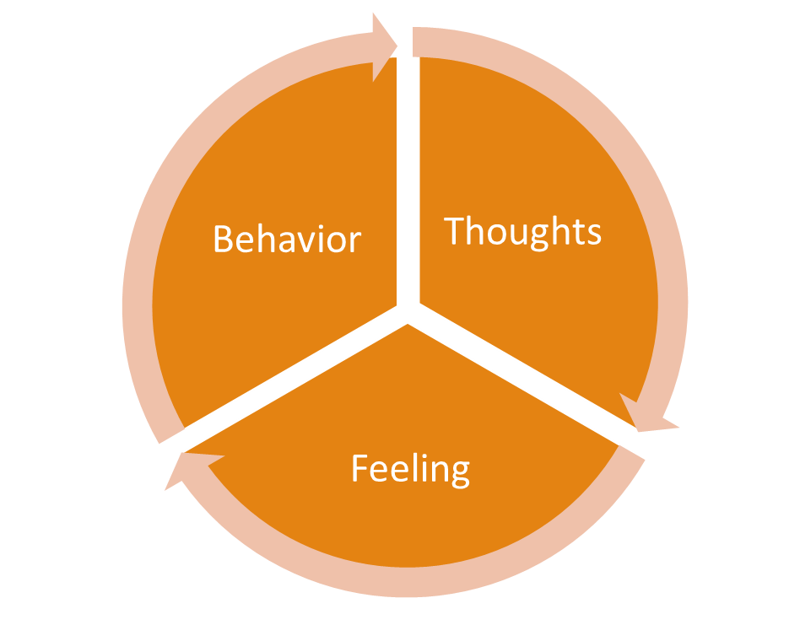
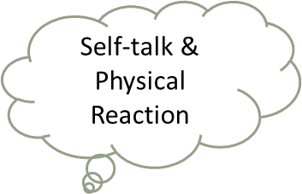
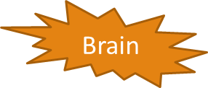
Thought Process
FRONTAL LOBE- 2 Parts
SELF-TALK
Physical Response
Reward System
Reasoning
Organizing

Slide 3
Facts About the Brain
Right Side
Left Side
Store’s Autobiographical Memory
Hold’s Raw emotional needs and feelings
Personal Reflection
Looks Inward to Self and Others
Non-Verbal Connection with Others
Creative Imagination
Language and Logic
Linear Thinking
“Approach State”
Looks Outward to the World
Social Display of Rules
Box of Meaning

Slide 4
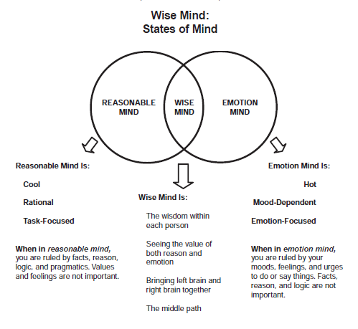
Mindsight— Intergration of the Brain
Three Skills Needed
1. Insight-The sense of inner connection of past, present, and future with a clear understanding of who you are.
2. Empathy- Having the sense and ability to “see” from an other’s perspective.
3. Integration- Link different parts, connecting in a whole way that promotes compassion and connection.

Slide 5
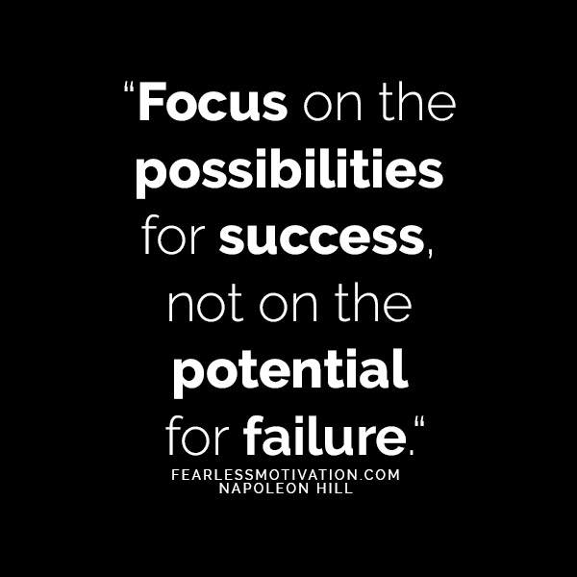
Brain Grows and is Shaped on What We Focus On!
“Between stimulus and response there is a space. In that space is our power to choose our response. In our response lies our growth and our freedom.”
Viktor E. Frankl

Slide 6
Thinking Error Definitions
All or Nothing Thinking: Absolutes; black and white; always or never; I can’t see someone else’s perspective
Over Generalization: A negative event as a pattern of defeat
Discounting the Positive: Positive perspective is less then or minimized; Strict focus on the negative
Mental/Logical Filter: Using only one or the other (frontal lobes) to make decisions. Wise-mind is using both
Emotional Filter: Using only one or the other (frontal lobes) to make decisions. Wise-mind is using both
Jumping to Conclusions: A. Mind-reading-when facts are not present, or emotion is assumed B. Fortune-telling-predict the future or tell someone how to they are going to feel.
Magnification or Minimization: blowing things out of proportion or shrink the positive
Should/Shame Statements: Should’s; musts; criticize self or others to add shame of worthlessness. Change to could
Labeling or Mislabeling: Labeling a group or shaming yourself without known facts or awareness
Personalization or Blame: Taking on someone else’s problems when it’s out of your control; Deny the role you played

Slide 7
Additional Defense Mechanisms
Denial -Individual pretends it didn’t happen and might fool him/herself into thinking it did and then denies it ever happened.
Shifting Focus -Individual turn peoples minds and attention onto something else, and distant them from the real issue.
Blaming Others or Victim- Individual blames the problem on his own behavior, someone else, or the victim. The victim brought it on himself or herself.
Intellectualization-Individual tries to use ideas or intellect to sidetrack from the issue by finding an excuse or explanations.
Playing Dumb- Individual acts or pretends he/she didn’t it was wrong or against the rules.
Rationalization -Individual finds excuses and explanations for behavior.
Justification -Individual finds reasons to explain “correctness” and that it was okay for the behavior.
Dismissal -Individual disregards, ignore, or brushes it under the rug others feelings or their behavior.
Projection- Individual projects traits in oneself and attributed to others or a group.
Avoidance -Individual avoids thinking about emotionally difficult subjects, as they feel overwhelmed.
Comparing- Individual may defend the ego by comparing themselves to those worse off. Similarly, we may see similarities between ourselves and others in a better position to improve our self image
Displacement- Individual takes feelings that belong in one situation and displace them on someone or something
Narcissistic Trait Thinking Errors:
Entitled -Individual feels as though they deserve good things, even though they have not worked for them.
Grandiose -Individual feels as though he/she is better then others and should be looked up to.
Revenge-Individual feels as though he/she has been wronged and is entitled to get revenge.
One Upsmanship -Individual feels he/she has to do better than everyone else, to show he/she is the best.

Slide 8
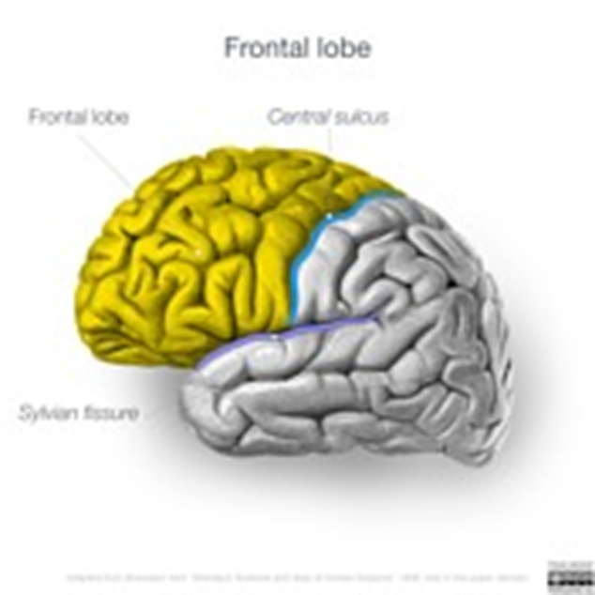
Self-Talk the Frontal Lobe
Thinking Errors are not FACTS
Ask yourself-Is this true?
How does this make me feel?
What if I did not hold this belief?
*4 main reasons why we do not self-talk
1.FFF 2.Burnout 3.Impaired 4.Mental Disorder

Slide 9
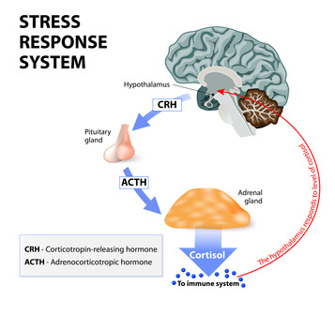
Behavior Process Fight Flight Freeze→ Mid Brain
Relationships and Self-Value
Aggressive (fight)-Direct w/ Disrespect
Passive Aggressive (flight)-Say Yes when you mean No
Passive (freeze)-Everyone else is right
Assertive- Direct w/Respect
I feel/ I need/ I am willing

Slide 10
Know your Thoughts and Emotions

Slide 11
Emotional Cycle Handout

Slide 12
Unlearn Past Chemicals
Don’t Let Chemicals Hijack the Brain
Allow Time and Practice
Two Chemicals- Love or Fear
Ask yourself- What are my unresolved/buried feelings and the belief system behind them?
Get to the ROOT to reduce stress and sickness!

Slide 13
Manage the Root Issues/Seeds
Leafy Issue
Failed relationships, Financial Issues,
Junk Values, Addiction, Thinking Errors
Trunk
2nd Emotion
Hurt, Inadequate, Raw, Stuck,
Fear, Anger, Betrayed, Hopeless
Root Issue
Loss, Grief, Trauma (developmental, relational, etc.), Self-Concept, Abandonment, Shame, Denial, Metal Health, Chronic Health

Slide 14
Balance of Basic Four—Time/Energy/Money

Slide 15
Burnout and Behavior
5 Stages of Burnout
Cognitive
Attention & processing reduces, short-term memory problems, judgment impaired, racing thoughts, ridged thinking, focus on the negative
Emotional
Increased irritability, frustration, impatience, depression, anxiety, hopelessness, confusion, numbness
Behavioral
Increased bad/nervous habits, sleep disturbances, impaired listening skills, withdrawal, aggression
Physiological
Rapid heartbeat, increased fatigue, illnesses, stomach problems, nausea, dizziness, aches, decreased libido, headaches, difficulty breathing, sweating
Honeymoon Stage
Onset of Stress
Chronic Stress
Burnout
Habitual Burnout
Burnout Reactions

Slide 16
Coping Skills Check List
Balance –Physical, Mental, Social, Emotional/Spiritual
Mindfulness
Logic and Emotion Together (wise-mind)
Create a Mental “Safe Space”
Reduce Thinking Errors
Burnout Prevention
Reduce Caffeine and/or Alcohol/Drug Use
Connection
Clean up Your Environment
Create a Reward System
Mini Vacations
Mindfulness
Self-talk
Relaxation Techniques (breathing)
Healthy Quick Stress Relievers (call)
Time–Out 10 minutes to 24 hours
Humor
Thought Stopping
Conflict Negotiation
Problem Solving
Challenge Thinking Errors
Choosing Assertiveness vs. Aggression

Slide 17
References
Brown, B. (2010). The power of vulnerability. TED Talk.
Brown (2010). The Gifts of Imperfection: Let Go of Who You Think You’re Supposed to Be and Embrace Who You Are
Brown (2012). Listening to Shame. TED Talk
Brown (2012). Daring Greatly: How the Courage to Be Vulnerable Transforms the Way We Live, Love, Parent, and Lead.
Brown (2012). The Gifts of Imperfect Parenting. Audible
Covey, S. R. (1989). The seven habits of highly effective people: Restoring the character ethic. New York: Simon and Schuster.
Goleman (1995). Emotional intelligence: Why it can matter more than IQ. New York: Bantam Books.
Goleman (2006). Social Intelligence: The New Science of Social Relationships. Bantam Books.
Frankl, V. E. (1984). Man's search for meaning: An introduction to logotherapy. New York: Simon & Schuster.
Maslash, C. & M. P. Letter, (2015) It’s Time to Take Action on Burnout. Burnout Research 2, IV-V
Patterson, Kerry. (Eds.) (2012) Crucial conversations: tools for talking when stakes are high New York : McGraw-Hill,
Van Epp, J. (2010). How to avoid falling for a jerk (or jerk-ette) (5th ed.). Medina, OH: Author.

