Slide 1
Turning to Your Teen Through Emotion CARYL WARD LCMHC, CFLE carylscounseling@gmail.com 801.999.0179

Slide 2
Emotion Before Behavior…
“Much of today’s popular advice ignores the world of emotions. Instead, it relies on child-rearing theories that address the children’s behavior, but disregard the feelings that underlie that behavior” (Gottman, 1997)

Slide 3
Starts with Self-Discipline
>3 R’s Routine- Fixed Program
Responsibility-Having a Duty
Reassurance-Fears are Unseen and Real
*See Handout Caryl Ward LCMHC, CFLE ©

Slide 4
The Five R’s of Self-Discipline
Routine- Find new traditions, play, and creative TIME together
Responsibly- Love & Logic = Choices = Power = Thinking Words not Fighting Words
Reassurance- Model emotions by validation and empathy
Reward- Set up new Reward System (by your teen’s Love Languages)
Resilience- Instill HOPE by telling the story

Slide 5
Emotion ¼ of your Balance

Slide 6
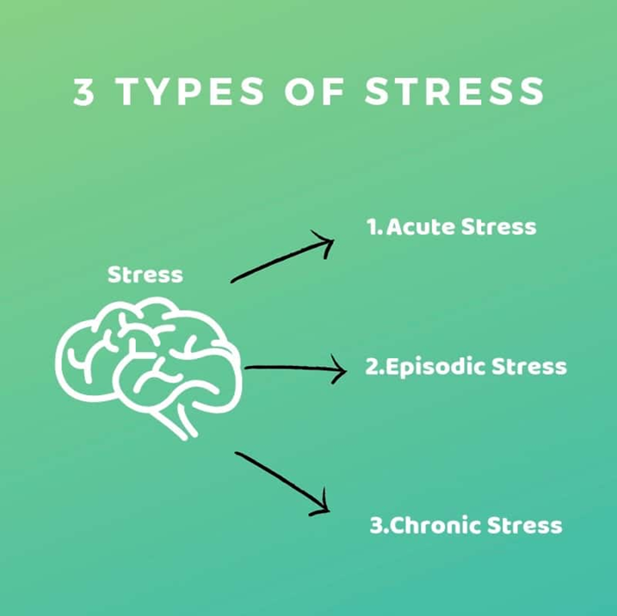
Three Stages of Stress
Traumatic Events
1. Acute Stress
One Month, Short Term
2. Adjustment
Six Months
3. Post Traumatic
Three-Six Months Plus, Long Term
Trauma Emotions of Loss, Grief, Powerless
Unseen vs. Seen

Slide 7
Symptoms of Stress/Burnout

Slide 8
Stress In Teens
According to data collected by the American Psychological Association for the Stress in America Survey, teen stress rivals that of adults. Results of the survey show that not only do teens identify that their stress levels are not healthy, but they also underestimate the impact stress has on their mental and physical health.
For teens, the most commonly reported sources of stress are school (83%), getting into a good college or deciding what to do after high school (69%), and financial concerns for their family (65%).
Many teens report lying awake at night (35%), overeating or eating unhealthy foods (26%), and skipping meals (23%) due to stress in the past month.
40% of teens report feeling irritable or angry, 36% report feeling nervous or anxious, 36% report feeling fatigued or tired, and 31% report feeling overwhelmed due to stress in the past month.

Slide 9
Symptoms of Stress/Burnout
Cognitive
Attention & processing reduces, short-term memory problems, judgment impaired, racing thoughts, ridged thinking, focus on the negative
Emotional
Increased irritability, frustration, impatience, depression, anxiety, hopelessness, confusion, numbness
Behavioral
Increased bad/nervous habits, sleep disturbances, impaired listening skills, withdrawal, aggression
Physiological
Rapid heartbeat, increased fatigue, illnesses, stomach problems, nausea, dizziness, aches, decreased libido, headaches, difficulty breathing, sweating

Slide 10
Primary to Secondary
Frustration
Outraged
Insecure
Lonely
Worthless
Jealous
Annoyed
Hurt
Resentment

Slide 11
Primary/Secondary/Root Emotions
Sad
Bored
Loss
Grief
Worried
Powerless

Slide 12
5 Steps to Emotional Coaching
Become Aware and Intelligent of ALL Emotions
Recognize an Opportunity for Teaching and Intimacy
Listen, Validate, and Reflect
Coach the Child to Label How They Feel
Set Limits and Problem Solve (Gottman 1997)

Slide 13
1. Become Aware and Intelligent of ALL Emotions
The parent must be aware of and be comfortable with their own emotions first and experience them daily. It is crucial in allowing for all feelings in a non-shaming way. Start by writing down your secondary emotions everyday.
TIPS for Teens/Parents
Keep emotional journals that is color coordinated. Try to find at the least 30. Help your teen find 10 plus a day.
Emotion bags of SAD or MAD or HAPPY of things that add to that emotion and help self-regulate with all five senses.

Slide 14
2. Recognize an Opportunity for Teaching and Intimacy
As parents we need to teach by modeling empathy, to build intimacy, trust, how to “sit” in a strong emotion, and how to produce a behavior after the emotion. All emotions are not a threat to our authority or something WE need to FIX.
TIPS for Parents
Show that you are their ally and face struggle together…that they are not alone or weak. Know what empathy really is. Be constituent with your response and emotion and model that.

Slide 15
Bit on Empathy
“When you get to a place where you understand that love and belonging, your worthiness is a birthright and not something you have to earn, anything is possible.” BB

Slide 16
3. Listen, Validate, and Reflect
You can listen in many different ways to your child. With physical evidence, seeing your child's perspective, and with reflection of facial response. But most important with your heart. “I can see why you would be so upset, I would be too,”
TIPS for Parents
Observation is best! State what you see, hear, feel, touch! No correction, or fixing at this point. No questions, just statements.
Unhelpful thinking errors –jumping to conclusions, mind reading, ridged thinking, overgeneralization, discounting the positive ECT.

Slide 17
4. Coach the Child to Label How They Feel
After you have listened and empathized, and been in their “space”, you label and/or investigate the emotion your child is having in that moment. State what you see and hear, not what the child OUGHT do or feel. Explain when the last time you felt this way if appropriate. Label and investigate several secondary emotions.
Tips
Try this verbiage! You look_____. It seems_____. Its normal for______. I can see_____. What does your body feel like? I see that you are crying, kicking, yelling, shaking, etc. Put a number on it, 1-10. 10 being an extreme.
Have your child list what they have power over and what they don’t. Ask what part of the powerless feelings can your child find?

Slide 18
5. Set Limits and Problem Solve
There are five steps inside this step!
1. State clear limits on behaviors, actions, appropriate wishes that align with your family value system (if you don’t know what those are, find them). Provide pre-set consequences that are consistent and fair related to the behavior not the emotion.
2. Identify the goal and what you would like to accomplish with this strong emotion and if it resulted in a behavior that needs to be repaired go to a solution (broken item from a tantrum).
3. Think of a possible solution towards the goal and what works best for self-regulation, recognizing emotion, or just sitting in it.
4. The solutions have to align with your family values and the child’s.
5. Help your child to find solutions by choices, encouragement, coaching, challenging, and processing the outcome with logical thinking. Sometimes a good distraction helps!

Slide 19
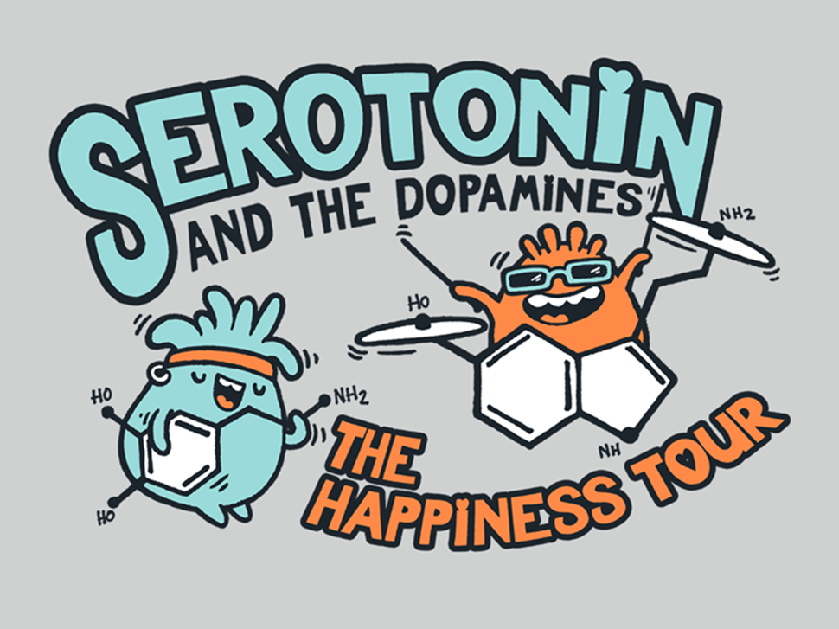
Boost Happy Hormones
Sleep!!
Diet/Protein
Imagination
Creativity
Movement
Connection
Music
Pets
Walking
Writing/Tracing/Coloring
Vitamin D3
Magnesium (citrate)
Apple Cider Vinegar
Vitamin C
Zinc
B Complex
L-Tyrosine
L-Theanine
Iron
SSRI’s

Slide 20
Tips and Check List for Teens
Good Distractions 10 minutes-2 hours
vs. Avoidances-2 hours plus
Creative/Play Activates
Limit Screen Time/Media
Increase Humor
Routine
Timer as the BOSS
Reach OUT!
UTAH SAFE APP
SUICIDE CRISIS LINE 1-800-273-TALK
DOMESTIC VIOLENCE 1-800-897-LINK (5465)
UNI CrisisLine-801-587-3000
BH Crisis 24/7 1-800-926-9619
Balance
Mindfulness
Logic and Emotion Together
Create a Mental “Safe Space”
Reduce Caffeine
Connection
Reduce Thinking Errors
Clean up Your Environment
Create a Reward System
Mini Vacations

Slide 21
References
Brown, B. (2010). The power of vulnerability. TED Talk.
Brown (2010). The Gifts of Imperfection: Let Go of Who You Think You’re Supposed to Be and Embrace Who You Are
Brown (2012). Listening to Shame. TED Talk
Brown (2012). The Gifts of Imperfect Parenting. Audible
Brown (2015). Rising Strong: How the Ability to Reset Transforms the Way We Live, Love, parent, and lead
Cline, Fay (2016) Parenting Teens With Love And Logic: Preparing Adolescents for Responsible Adulthood
Chapman & Campbell (2012) The Five Love Languages of Children
Gottman, J. M. & DeClair, J. (1997). The Heart of Parenting: Raising an Emotionally Intelligent Child. New York: Simon & Schuster.
Siegel, D. J., & Payne Bryson, T. (2011). The whole-brain child: 12 revolutionary strategies to nurture your child's developing mind. Bantam Books.
Tuning into Teens Handouts 2,3,4,5 and 6 CARE
https://www.ehcap.co.uk/content/sites/ehcap/uploads/NewsDocuments/297/MEC-No-NOTES-22-April.PDF

