Slide 1
Taking Care of Your Mental Health
Caryl ward Lcmhc, cfle

Slide 2
Improve and Maintain Mental Health
By Knowing and Staying in Balance
Physical, Mental, Social, Emotion/Spiritual
Preventing Burnout with Proactive Behavior
Reset and Repair
Practicing Coping Skills
Mindfulness, Management, Maintenance

Slide 3
It’s All About How We Think, Feel, and Behave
Thoughts
Feeling
Behavior
Self-talk &
Physical Reaction
Brain

Slide 4
Balance of Four—Time/Energy/Money

Slide 5
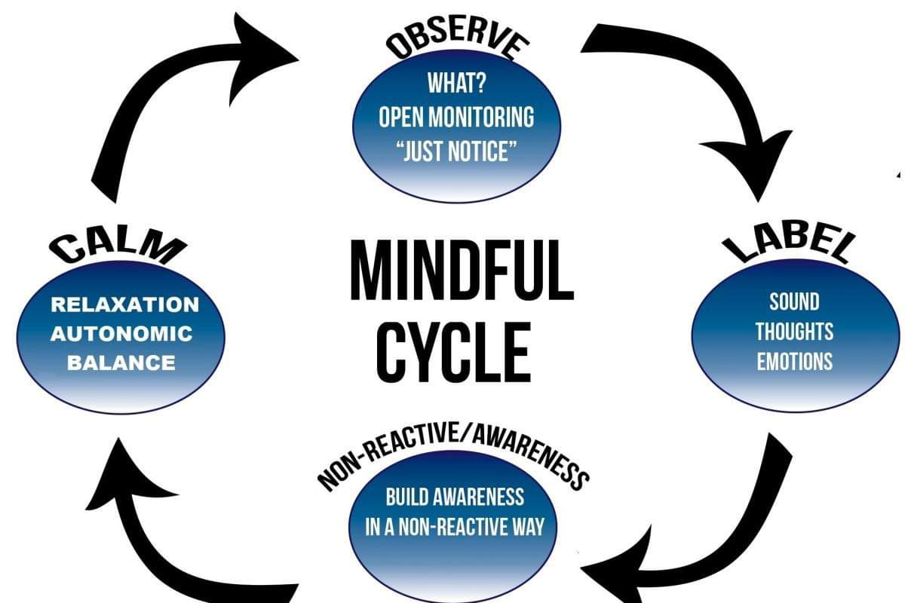
Know your Thoughts and Emotions

Slide 6
Thoughts Facts or Error
Definitions
All or Nothing Thinking: Absolutes; black and white; always or never; I can’t see someone else’s perspective
Over Generalization: A negative event as a pattern of defeat
Discounting the Positive: Positive perspective is less then or minimized; Strict focus on the negative
Mental/Logical Filter: Using only one or the other (frontal lobes) to make decisions. Wise-mind is using both
Emotional Filter: Using only one or the other (frontal lobes) to make decisions. Wise-mind is using both
Jumping to Conclusions: A. Mind-reading-when facts are not present, or emotion is assumed B. Fortune-telling-predict the future or tell someone how to they are going to feel.
Magnification or Minimization: blowing things out of proportion or shrink the positive
Should/Shame Statements: Should’s; musts; criticize self or others to add shame of worthlessness. Change to could
Labeling or Mislabeling: Labeling a group or shaming yourself without known facts or awareness
Personalization or Blame: Taking on someone else’s problems when it’s out of your control; Deny the role you played

Slide 7
Feelings/ Secondary Emotions
1. OBSERVE
- Note mental and physical feeling
- Label Primary and Secondary Emotion
- Rate your emotion 1-10
Release Fight, Flight, and Freeze to achieve Wise Mind (frontal lobes)
2. EXPERIENCE
- Try not to Block or Push it
- Be a witness to the emotion
- Be present
- Observing 5 senses

Slide 8
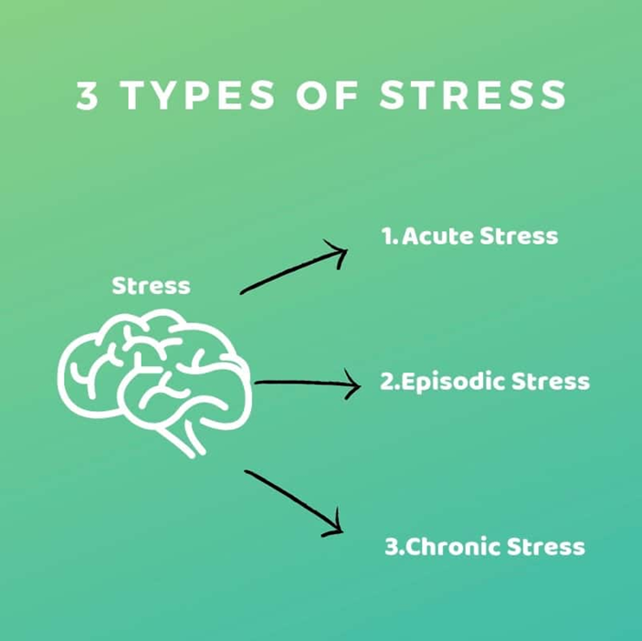
The Unknowns & The Unseen
Traumatic Events
Acute Stress
One Month, Short Term
Adjustment
Six Months
Post Traumatic
Three-Six Months Plus, Long Term
Trauma Emotions of Loss, Grief, Powerless
Unseen vs. Seen

Slide 9
Burnout and Behavior What is your normal level of Functioning? Stress hormones restrict Mood, Memory, Motivation, and Management
5 Stages of Burnout
Burnout Reactions
Honeymoon Stage
Onset of Stress
Chronic Stress
Burnout
Habitual Burnout
Cognitive
Attention & processing reduces, short-term memory problems, judgment impaired, racing thoughts, ridged thinking, focus on the negative
Emotional
Increased irritability, frustration, impatience, depression, anxiety, hopelessness, confusion, numbness
Behavioral
Increased bad/nervous habits, sleep disturbances, impaired listening skills, withdrawal, aggression
Physiological
Rapid heartbeat, increased fatigue, illnesses, stomach problems, nausea, dizziness, aches, decreased libido, headaches, difficulty breathing, sweating

Slide 10
Mindfulness
The focus on what’s right in front of you, turning to your physical sensations with full awareness. Letting go of thoughts of the past or future without judgment.
Pause throughout the day with present mindfulness, walking, eating, imagery, or body scan
Three ways to Calm the Autonomic Nervous System
Four Square Breathing
Trace or color
Focus Point
http://www.freemindfulness.org/download
http://www.livingwell.org.au/mindfulness-exercises-3/8-mindfulness-of-thoughts/

Slide 11
Mental Health Coping Tips
Family
Self
Good Distractions 10 minutes-2 hours
vs. Avoidances-2 hours plus
Creative Play Activates
Limit Screen Time/Media
Increase Humor
Routine
Timer as the BOSS
Reach OUT!
UTAH SAFE APP
SUICIDE CRISIS LINE 1-800-273-TALK
DOMESTIC VIOLENCE 1-800-897-LINK (5465)
CrisisLine-801-587-3000
Balance
Mindfulness
Logic and Emotion Together
Create a Mental “Safe Space”
Reduce Caffeine and/or Alcohol
Connection
Reduce Thinking Errors
Clean up Your Environment
Create a Reward System
Mini Vacations

Slide 12
References
Maslash, C. & M. P. Letter, (2015) It’s Time to Take Action on Burnout. Burnout Research 2, IV-V

