Slide 1
Love & Logic and Types of Parenting Styles What Works and What Doesn’t in Order to Raise Responsible Children
Caryl Ward LCMHC, CFLE

Slide 2
4 Types of Parenting -Ineffective by Baumrind, Gottman, Love& Logic
Authoritarian
Disapproving
Drill Sergeant
Too Hard, Aggressive, High Demands, Battle, Strict, Punishment, Harsh, Emotion Distant, Cold, Inflexible, Clear Rules, Fighting Words
Neglectful
Dismissive
Turbo Attack H. P.
Too Self-Absorbed, Passive-Aggressive, Does not Attend to Needs, Little Interaction, Unattached, Shame Emotions, Rescue out of Guilt, Avoids Failure, Blast Away
Permissive
Laissez Faire
Helicopter Parent
Too soft, Passive, Overly responsive, No enforcement, Few rules, Friend Zone, Warm, Emotions are OK, But No Guidance, Run Free, Over Protection, Hovers, Overlooks

Slide 3
4 Types of Parenting -Effective Type
Authoritative
Emotion Coaching
Effective Parenting
Just Right, Assertive, Advisors, Consistent, Awareness, Problem Solving, Limits, Patience, Respect, Empathy, Nurturing, Identification, No Dictation, Coach &Challenge, Thinking Words, Choices, Options, Clear, Natural Consequences, Allows Failure, Model Behavior
= Responsibly, Self-Identity/Concept, Independence, Healthy Social Skills, Opinions, Emotional Intelligent, Self-Disciplined, Competent, A WIN WIN!!

Slide 4
Self-Concept Starts at Home! The Three Legged Table (pg. 37-38)
Baumeister (1999) provides the following self-concept definition: "The individual's belief about himself or herself, including the person's attributes and who and what the self is".
It is learned, not inherent
It is influenced by biological and environmental factors, but social interaction plays a big role as well
How you think others view you
Self-concept is related to several other “self” constructs, such as self-esteem, self-image, self-efficacy, and self-awareness (positivepsychology.com).

Slide 5
Continued….The Three Legged Table of Self-Concept
Power vs Powerless
I’m loved by “magical” people
I have skills
If I face it I will make it
I am capable to take control

Slide 6
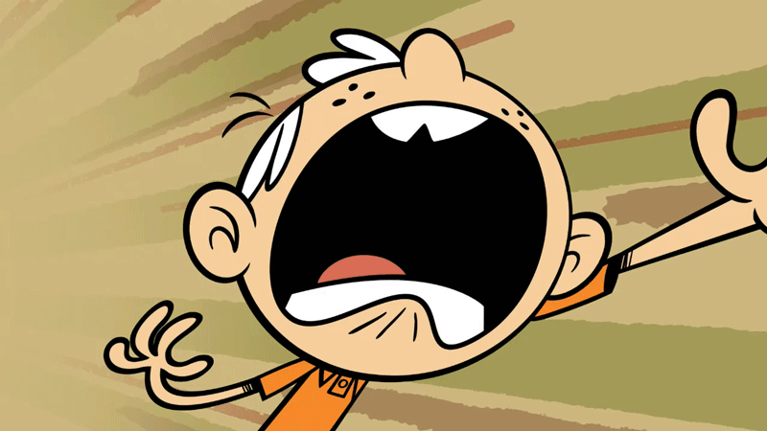
Thinking Words not Fighting Words (Pg. 69)
Soft start-up or Harsh start-up
Start with a question and two options
Reduces pressure
Gives power
Increases self-esteem and self-concept
Teaches responsibility
They can figure it out

Slide 7
Fighting Words
You get to work on that right now
You’re not going to talk to me like that
Quit fighting or What are you doing that for
Be Quiet, because I said so

Slide 8
V of Love the Right Dose by Sylvia Rimm PHD pg. 82
Elementary
Toddler
Birth
Jr. High
High School
Limits
Choices

Slide 9
Modeling The Love & Logic Way “Don’t get too uptight if our children don’t always listen to us, but tremble in fear that they see what we do.”
Find a Higher Purpose through family values
What they see is what they learn
Cost of learning is going up
Authoritative parenting
Action more then words
Look at “Pearls” 33, 26, 41, 43
Tip 8 pg. 49

Slide 10
Stop with the Praise and Stuff
Stuff
&
Praise
Encouragement
&
Appreciation

Slide 11
Recap with Tip’s
No threat cycle
Don’t give warnings
Gain control through Choices
Boundaries not Battles
Thinking words, then allow for mistakes
“Yes” be Yes and your “No” be yes too (tip 17 pg. 79)
Consequences can be delayed
Model Empathy and Emotional Coach
Egg timer, make “TIME” the boss

Slide 12
Statements & Self-Talk Tips
“I know”
“Nice Try”
“I love you too much to ____”
“I’m Sure you can/will figure it out.”
It seems like …2nd Emotion___, you can ___ or ___
I can see_____
What will I Allow
What will I Do
What will I Provide

Slide 13
Non-Compliance pg. 84 tip 19 “I don’t have to do anything you say.”
Avoid a control battle at all costs
If you are going to get in one, WIN!
Pick the issue carefully
Practice and Repeat
Children's job is to push limits, it’s your job to hold them
Remember the cost is going up! (tip 3 pg. 31)
To protect them is not to love them
“Responsibility can not be taught it must be caught.” (pg. 34)

Slide 14
References
Cline, Fay (2016) Parenting With Love And Logic
Cline, Fay (2016) Parenting Teens With Love And Logic: Preparing Adolescents for Responsible Adulthood
https://www.loveandlogic.com

