Slide 1
Boundaries with Toxic Behavior CARYL WARD LCMHC, CFLE carylscounseling@gmail.com 801.999.0179 cell paperbackconnections.com

Slide 2
Why Boundaries…
Better Mental and Emotional Health
Avoidance of Burnout and Better Balance
Development of Autonomy and Identity
Reduction of Relational Trauma and Shame
What are boundaries
Why we need them
Triangle trap with Toxic Behavior
Relational Trauma
Balance and Values
Take home

Slide 3
boundaries are…
Guidelines, rules, expectations, limits, needs, protection, empowering, communication, healthy, personal, assertive, respectful, valuable, difficult, dividing line, balance, vulnerability, equalizes, modeling, teaching, responsivity, courageous, safety, preserve and deepen relationships
Six types
Physical—personal space, and physical touch
Intellectual—refer to thoughts and ideas. Dismissing or belittles ideas or options
Emotional—personal feelings and limits to share and invalidates
Sexual—emotional, intellectual, and physical aspects of sexuality, unwanted pressure
Material—personal money or possessions of materials
Time—how time is spent or violated from an other person
Tip-Just pick one category/type and improve it over a month within your relationships

Slide 4
“Living big” with Boundaries
“How can we expect people to put value on our work when we don’t value ourselves enough to set and hold uncomfortable boundaries?” Brown (2015) Rising Strong, pg. 115
Compassionate people have boundaries that combat resentment
The common denominator in Brene Brown’s research was, SHAME resilient people had boundaries

Slide 5
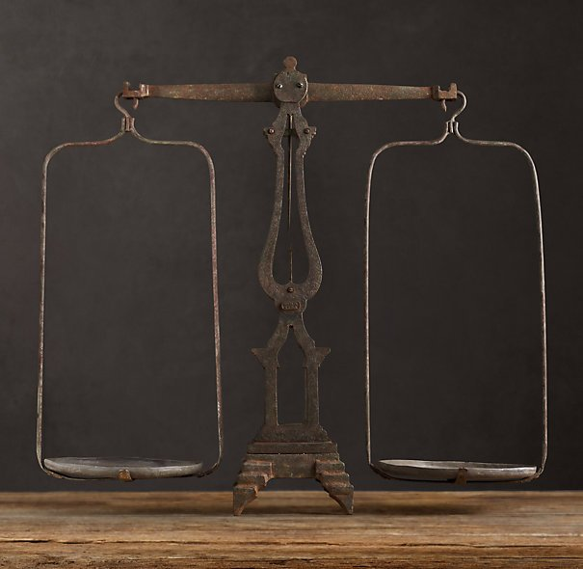
boundaries are not…
To fix, change, or punish the receiver or giver
For the receiver or violator to
blame, shame, label, or guilt trip
To be ignored or be Unequal
To be aggressive or passive
Impersonal
Against your value system

Slide 6
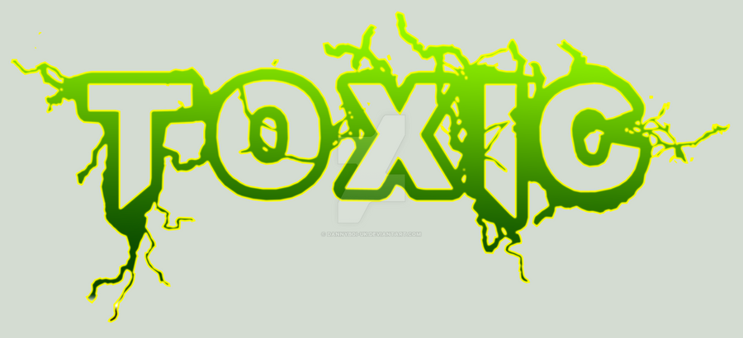
Toxic Behavior is…
Create drama/trauma triangle
Manipulate or control others
Being needy (“it is all about them all the time”)
Use others to meet their needs (such as a “narcissistic parent”)
Being extremely critical of themselves and others;
Being jealous and envious of others
Abuse substances or self-harm and be unwilling (or unable) to seek help
Violate your boundaries (jerk qualities)

Slide 7
What Happens to You…
You’re emotionally affected by their drama (shut down)
You dread (fear) being around them (avoid)
You’re exhausted or you feel angry while you’re with them or after your interaction (drained)
You feel bad or ashamed about yourself (worthless)
You’re stuck in a cycle of trying to rescue, fix or be the care-giver (syndrome)
Loose your values (self-worth)
Become burnt-out (relationship burnout, FFF)
You enter a syndrome (codependent)

Slide 8
Stephan Kapman Conflict Triangle
Parent
Adult
Child

Slide 9
Parent/Child/Adult Relationship
STOP the Drama/TRAUMA by Coaching and Challenging and Staying in YOUR Role
Parent
Adult
Challenger
Coach
Be the One to Change the Conflict and Get OUT
Transactional analysis is based on the idea that one’s behavior and social relationship reflects an exchange between parental (critical/nurturing), adult (rational) and childlike (intuitive/dependent) aspects of personality developed early in life.
Child
Thriver

Slide 10
Drama Triangle/Conflict Concept
A stable pair can become destabilized by a third person
A stable pair can also be destabilized by removal of the third person (child leaving home)
An unstable pair can be stabilized by the addition of a third person (contentious marriage becomes harmonious after the birth of a child)
An unstable pair being stabilized by the removal of the third person
(Bowne, 1966)
https://www.bpdfamily.com/content/karpman-drama-triangle

Slide 11
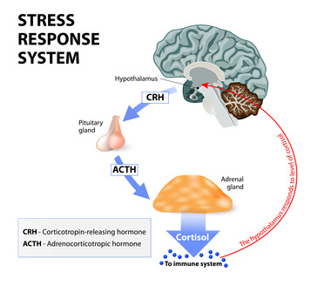
Burnout and Behavior
What is your normal level of Functioning? Stress hormones restrict Mood, Memory, Motivation, and Management of Assertive Behavior

Slide 12
Burnout and Behavior
5 Stages of Burnout
Burnout Reactions
Cognitive
Attention & processing reduces, short-term memory problems, judgment impaired, racing thoughts, ridged thinking, focus on the negative
Emotional
Increased irritability, frustration, impatience, depression, anxiety, hopelessness, confusion, numbness
Behavioral
Increased bad/nervous habits, sleep disturbances, impaired listening skills, withdrawal, aggression
Physiological
Rapid heartbeat, increased fatigue, illnesses, stomach problems, nausea, dizziness, aches, decreased libido, headaches, difficulty breathing, sweating
Honeymoon Stage
Onset of Stress
Chronic Stress
Burnout
Habitual Burnout

Slide 13
Balance of Basic Four—Time/Energy/Money

Slide 14
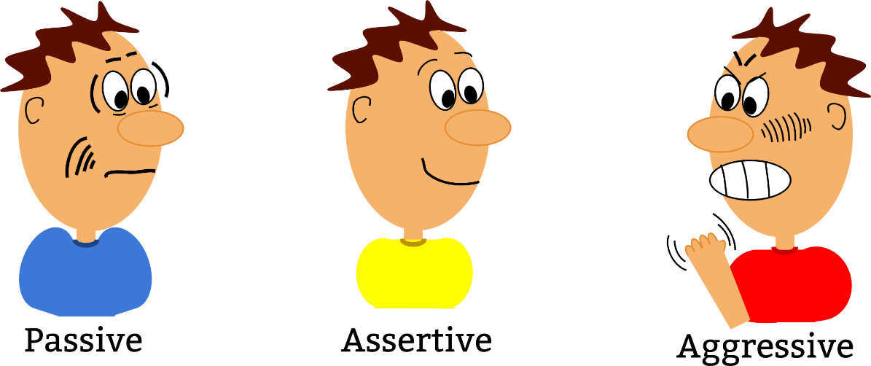
Assertive Behavior Process Fight Flight Freeze→ Mid Brain
Relationships and Self-Value
Aggressive (fight)-Direct w/Disrespect
Passive Aggressive (flight)-Say Yes when you mean No
Passive (freeze)-Everyone else is right
Assertive- Direct w/Respect; Hold on to Values

Slide 15
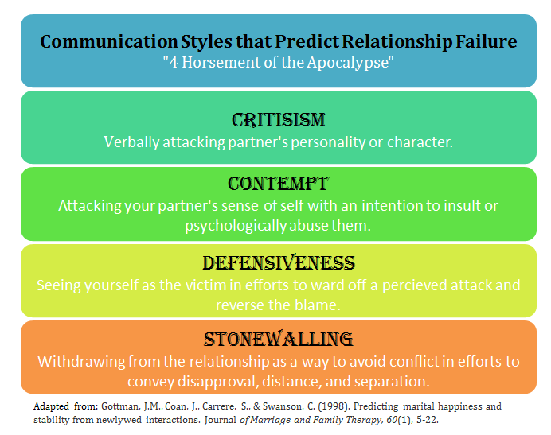
Avoid- Gottman 4 Horseman

Slide 16
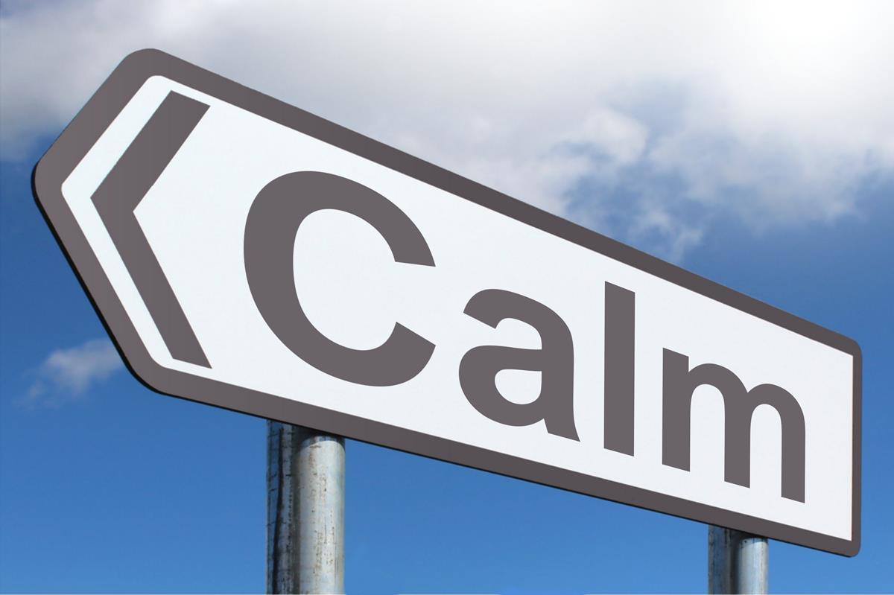
Tips to Reduce Conflict
Time Outs (10 mins.-24 hours)
Thinking Error replacement (thinking error 101)
Stay Present (don’t jump to conclusions)
Know what is REALLY going on (root issue)
Be emotionally intelligent (2nd emotions)
Listen to Seek to Understand (habit 5 in Steven Covey)
Logical impact (self-talk the pro’s/con’s)
Find a win-win and manage it (business deal)
No Four Horseman
https://www.youtube.com/c/BlomquistHale/videos

Slide 17
10 Ways to Have Boundaries & Values
Be assertive with Body language, call it what it is, I feel/I need/I will statements
Know your value system
Know your Secondary Emotion (Fear)
Be present-FFF does not work
Give yourself permission
Go by patterns not potential
Know self-care needs
Know when your values have been crossed
Know your rights, don’t apology
Rehearse and Repeat

Slide 18
Take Home…
Boundaries are not created to cause offense, rather they are created to honor you!
“Readers of the Human Magnet Syndrome will better understand why they, despite their dreams for true love, find themselves hopelessly and painfully in love with partners who hurt them.”
Know what Jerk qualities are (Jerk Book)
Learn and practice assertive skills to stay in frontal lobes and out of burnout
Avoid the four horseman and aggressive behavior
Know your worth and when to call it quits
Heal from repeated Relational Trauma

Slide 19
Resources
Brown (2015). Rising Strong
Cloud (2001). Boundaries with Kids
Cloud (2002). Boundaries in Marriage
Covey, S. R. (1989). The seven habits of highly effective people: restoring the character ethic. New York: Simon and Schuster.
Gottman, J. M., & Silver, N. (1999). The seven principles for making marriage work. New York: Three Rivers Press.
https://psychcentral.com/blog/whats-a-toxic-person-how-do-you-deal-with-one
https://www.gottman.com/blog/the-four-horsemen-recognizing-criticism-contempt-defensiveness-and-stonewalling
https://www.google.com/books/edition/Boundaries_with_Kids/sRo0ln91OpUC?hl=en&gbpv=1&printsec=frontcover
Lerner, H. G. (1986). The dance of anger: A woman's guide to changing the patterns of intimate relationships.
Lerner, H. G. (2017). Why won’t you apologize? Healing big betrayals and everyday hurts.
Patterson, Kerry (Eds.) (2012). Crucial conversations: tools for talking when stakes are high New York : McGraw-Hill
Ross (2013). The human magnet syndrome : why we love people who hurt us
Van der Kolk, B. A. (2014). The body keeps the score: Brain, mind, and body in the healing of trauma. New York: Viking.
Van Epp, J. (2010). How to avoid falling for a jerk (or jerk-ette) (5th ed.). Medina, OH: Author.
Warsha (2010). Divorce Poison: How to Protect Your Family from Bad-mouthing and Brainwashing

