Slide 1
Burnout vs. Balanced CARYL WARD LCMHC, CFLE caryl@blomquisthale.com 801.999.0179 cell 801.262.9619 office

Slide 2
Balance to Prevent Burnout
By Knowing and Staying in Balance
Physical, Mental, Social, Emotion/Spiritual
Preventing Burnout with Proactive Behavior
Reset and Repair the Body and Mind with the 5R’s
Routine, Responsibility, Reassurance, Reward, Resiliency
Practicing Coping Skills
Mindfulness, Mood Regulation, Management, Motivation (last stage), Maintenance

Slide 3
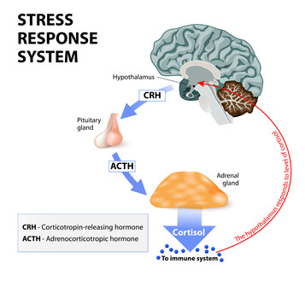
Burnout and Behavior
What is your normal level of Functioning? Stress hormones restrict Mood, Memory, Motivation, and Management

Slide 4
Burnout and Behavior
5 Stages of Burnout
Burnout Reactions
Cognitive
Attention & processing reduces, short-term memory problems, judgment impaired, racing thoughts, ridged thinking, focus on the negative
Emotional
Increased irritability, frustration, impatience, depression, anxiety, hopelessness, confusion, numbness
Behavioral
Increased bad/nervous habits, sleep disturbances, impaired listening skills, withdrawal, aggression
Physiological
Rapid heartbeat, increased fatigue, illnesses, stomach problems, nausea, dizziness, aches, decreased libido, headaches, difficulty breathing, sweating
Honeymoon Stage
Onset of Stress
Chronic Stress
Burnout
Habitual Burnout

Slide 5
Balance of Basic Four—Time/Energy/Money

Slide 6
Balance Starts with Self-Discipline
5 R’s
Routine- Fixed Program
Responsibility-Having a Duty
Reassurance-Fears are Unseen and Real
Reward-Schedule it!
Resiliency
Takes TIME
6 Stages of Change
Caryl Ward LCMHC, CFLE ©

Slide 7
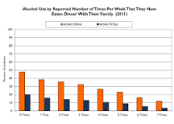
Physical Balance
Sleep
Even more important to sleep well to reduce burnout and depression
Diet
It’s hard to eat fresh healthy fruits and vegetables but family dinner is a must!
Exercise/Movement
Exercise outside/Inside
Without it…taxing on our immune systems
Movement apps
Sends good hormones
(https://youthservicesslc.wordpress.com/2012/06/05/3-reasons-for-family-dinner)

Slide 8
REM Sleep
Rapid Eye Movement (REM) Sleep: You generally enter REM sleep about 90 minutes after initially falling asleep, and each REM stage can last up to an hour. An average adult has five to six REM cycles each night. During this final phase of sleep, your brain becomes more active. This is when most dreaming occurs, your eyes jerk quickly in different directions, heart rate and blood pressure increase, and breathing becomes fast, irregular, and shallow. REM sleep plays an important role in learning and memory function, since this is when your brain consolidates and processes information from the day before so that it can be stored in your long-term memory.
https://www.sleep.org/

Slide 9
NREM Sleep
The period of NREM sleep is made up of stages 1 to 4. Each stage can last from 5 to 15 minutes. Stages 2 and 3 repeat backwards before REM sleep is attained.
During NREM sleep, the body repairs and regenerates tissues, builds bone and muscle, and appears to strengthen the immune system. As you get older, you get less NREM sleep. People under age 30 have about two hours of restorative sleep every night, while those over 65 might get only 30 minutes.

Slide 10
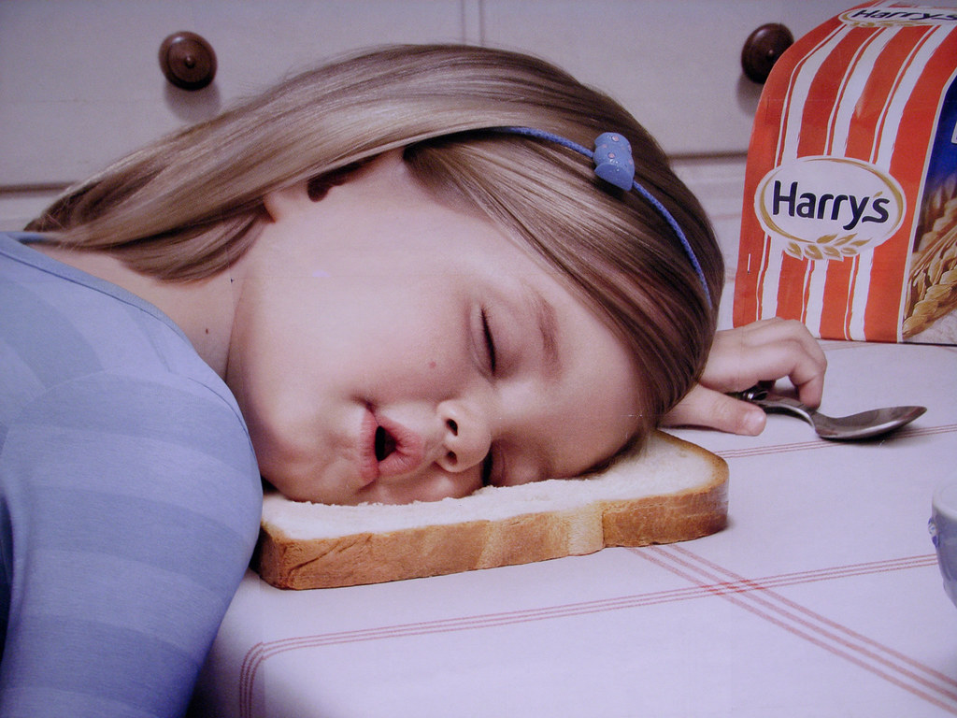
How Much Sleep is Needed
Benefits of REM sleep: better brain development, boost in memory, concentration, learning, mood, creativity, better immune system, less depression, more growth hormones, improved blood supply to muscles, better health overall, reduces heart disease and strokes and have a higher educational level.
Newborns 14-17 hours
Infants 12-15 hours
Teens 8-10 hours
Adults 7-9 hours
65 + 7-9 hours
American average- 7 hours with 35% report “poor” sleep quality. 7/10 high School age don’t get enough sleep.

Slide 11
Sleep Tips
Heating cold feet causes vasodilation—dilation of the blood vessels—which may tell the brain that it is bedtime. After the blood vessels open in the hands and feet, heat is redistributed throughout the body to prepare for sleep. In fact, some research has shown that the more vasodilation in the hands and feet, the less time it takes to fall asleep.
A spoonful of almond butter is a good source of magnesium. Having low magnesium levels puts you at a higher risk for insomnia, so it’s important to get enough of it. Also, Epson Salt bath does the same.
https://www.sleep.org/

Slide 12
Bedtime Routine to Finish the day
Sleep hygiene routine
Exercise/Stretch
Electronics off
1 hour before bedtime
Relaxation techniques
Hyper-sleep (YouTube)
Avoid caffeine
Reduce or avoid naps
20 minute rule
Get out of your bed
Read
Journal
Mind dump worries/emotions
Magnesium
(citrate/calm/glycine/chloride)

Slide 13
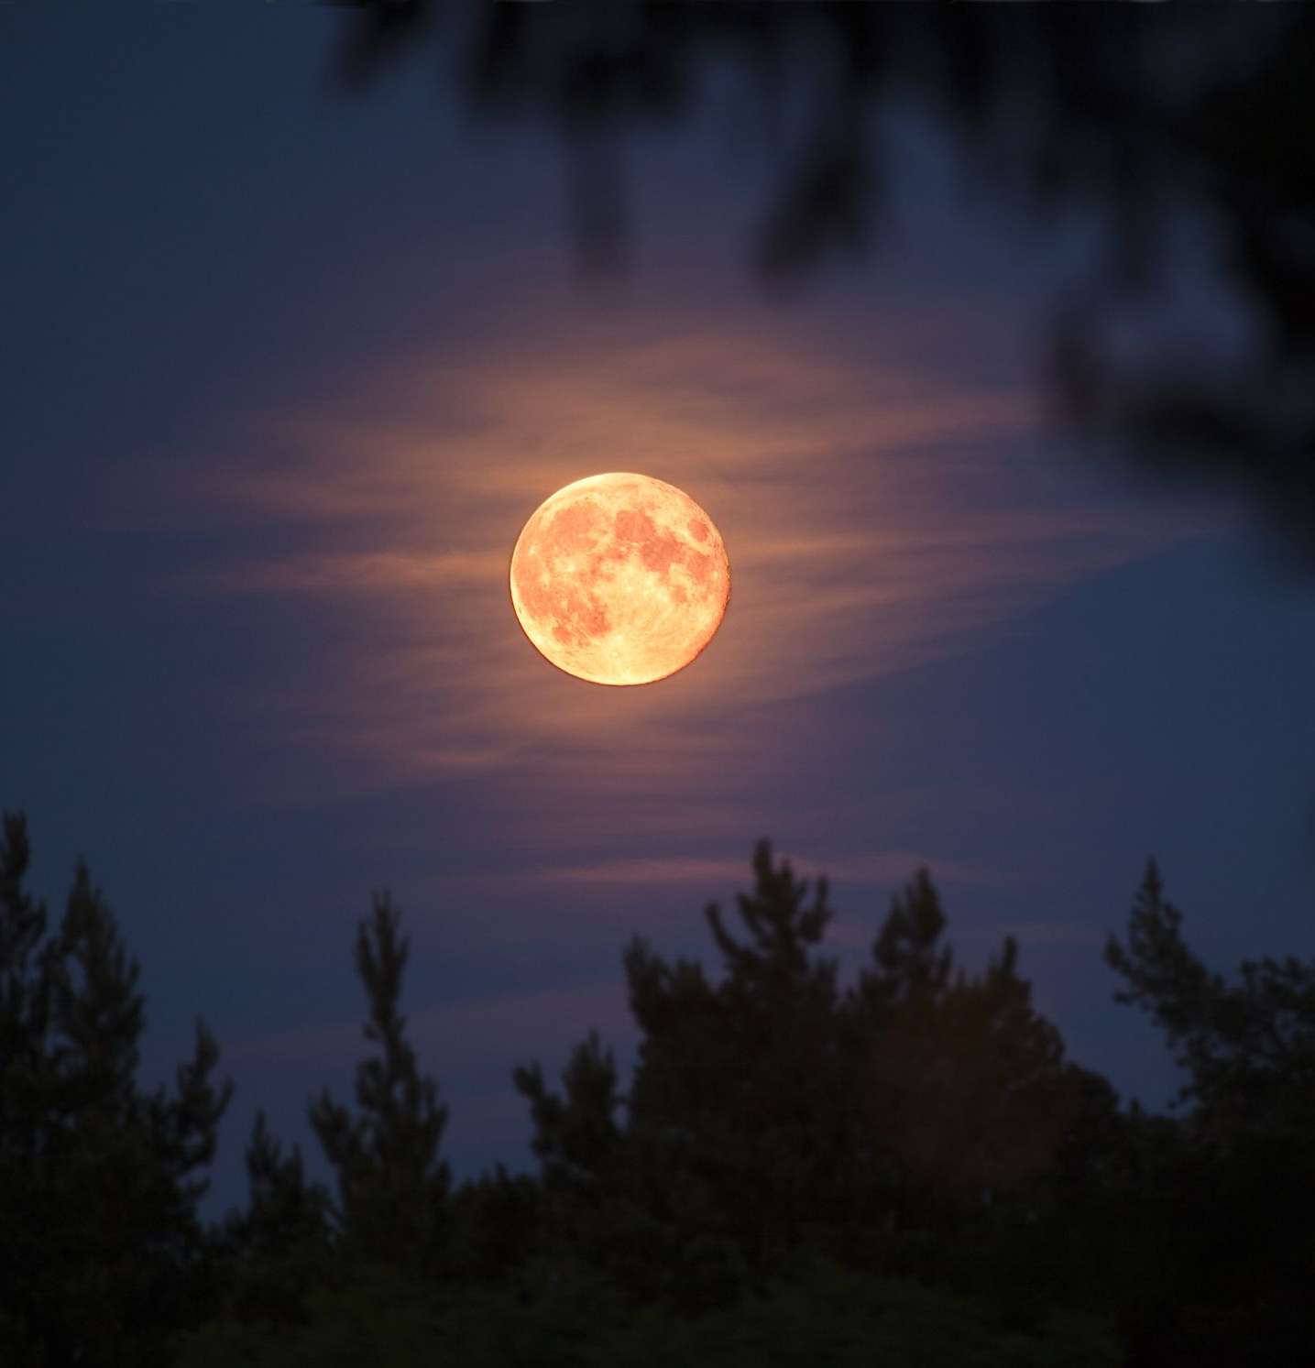
Questions to End the Day
End of the day
What went well today?
What are three things that I am grateful for? for?
What random act of kindness was I able to do do today?
Who did I connect with today?
How did I reduce stress and tension within myself and the family unit?
Are there any changes we need to make?

Slide 14
Morning
The best morning routine is one that is tailored to you
Wake up at same time
Morning routine
Avoid upsetting news and work emails
Read or listen to something motivational
Podcast, music, mediation
Exercise and hydrate
How to make this a great day
Journal/Planner
Get dressed for the day

Slide 15
Physical Balance –Immune system
Vitamin D3
Vitamin C
Zinc
Magnesium (citrate)
B6
Apple Cider Vinegar
Turmeric

Slide 16
Know your Thoughts and Emotions

Slide 17
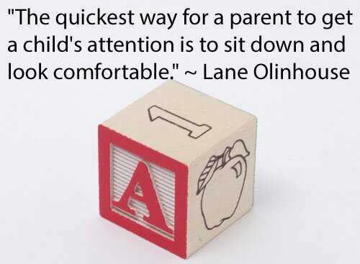
Mental Balance
Creative Play Activates
Limit Screen Time
Good Distractions 10 minutes-1 hour
vs. Avoidances-2 hours plus
Timer as the BOSS for Activities
Create a Mental “Safe Space”
Need—Hula-Hoop, Desk, Pillow/Beanbag, Stress Bag, Signs (Mommy’s on a call), Five senses/emotional bag

Slide 18
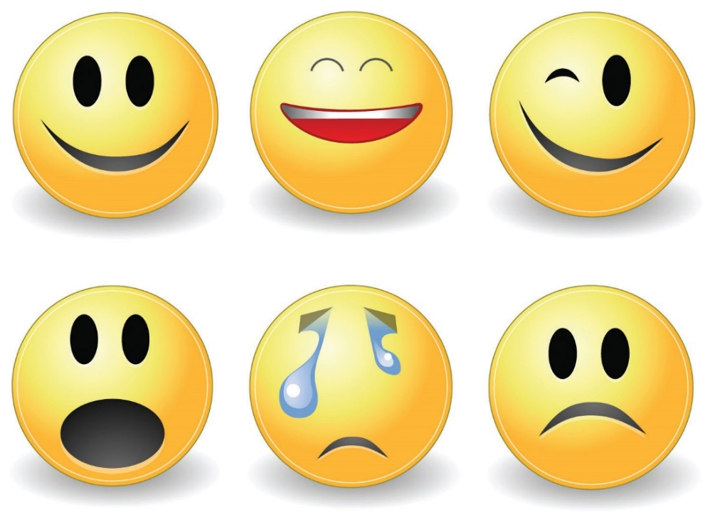
Emotion/Spiritual Balance Step 1
1. OBSERVE
- Note mental and physical feeling
- Label Primary and Secondary Emotion (10-30)
- Rate your emotion 1-10
- Release Fight, Flight, and Freeze
To achieve Wise Mind (frontal lobes)
- Record Emotions Daily

Slide 19
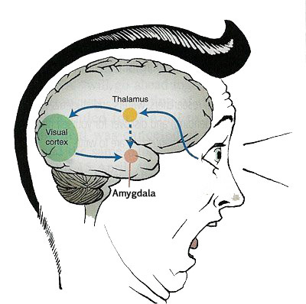
Emotion/ Spiritual Balance Step 2
2. EXPERIENCE
-Try not to Block or Push it (Don’t Stuff or Judge)
-Be a witness to the emotion
-Be present/ Be mindful
(see mindful slide)
-Observing 5 senses
-No Shame all emotions are signs

Slide 20
Screen Time Burnout?
Brewer, a leading neuroscientist and psychiatrist, studies human behavior and habits. He said the first step to preventing screen burnout is to map out what is going on in our minds when we are drawn to devices and how we feel after we use them. "What am I aiming to do? Is this to communicate with somebody? Is this because I'm forced to go on a meeting, and what is my habitual reaction?" he said. https://6abc.com/screen-time-quarantine-coronavirus-how-to-decrease/6113392/
During an in-person conversation, the brain focuses partly on the words being spoken, but it also derives additional meaning from dozens of non-verbal cues, such as whether someone is facing you or slightly turned away, if they’re fidgeting while you talk, or if they inhale quickly in preparation to interrupt.
https://www.nationalgeographic.com/science/2020/04/coronavirus-zoom-fatigue-is-taxing-the-brain-here-is-why-that-happens/

Slide 21
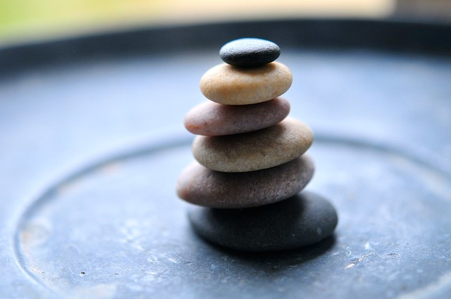
Mindfulness Coping
The focus is on what’s right in front of you, turning to your physical sensations with full awareness. Letting go of thoughts of the past or future without judgment.
2-10 Minute Distraction to Break the Urge
Pause throughout the day with present mindfulness, walking, eating, imagery, or body scan
Ways to Calm the Autonomic (Sympathetic) Nervous System
Four Square Breathing
Trace or Color or Record Feelings
Focus Point (hold a pen 6 inches from eyes)
Call Someone
Room Scan and Use 5 senses (point out what you see etc.)
Worry Bag (to take with you places)
http://www.freemindfulness.org/download
http://www.livingwell.org.au/mindfulness-exercises-3/8-mindfulness-of-thoughts/

Slide 22
Mental Health Coping Tips Family Self
Good Distractions 10 minutes-2 hours
vs. Avoidances-2 hours plus
Creative Play Activates
Limit Screen Time/Media
Increase Humor
Routine
Timer as the BOSS
Reach OUT!
UTAH SAFE APP
SUICIDE CRISIS LINE 1-800-273-TALK
DOMESTIC VIOLENCE 1-800-897-LINK (5465)
CrisisLine-801-587-3000
Balance
Mindfulness
Logic and Emotion Together
Create a Mental “Safe Space”
Reduce Caffeine and/or Alcohol
Connection
Reduce Thinking Errors
Clean up Your Environment
Create a Reward System
Mini Vacations

Slide 23
References
Cline, Fay (2016) Parenting Teens With Love And Logic: Preparing Adolescents for Responsible Adulthood
Gottman (1997) Raising An Emotionally Intelligent Child
Maslash, C. & M. P. Letter, (2015) It’s Time to Take Action on Burnout. Burnout Research 2, IV-V
https://www.sleepfoundation.org/articles/why-your-child-needs-sleep-schedule-throughout-summer
https://www.youtube.com/watch?v=Kvs-_22lwjA (Dr. Wayne 5 mins before bed positive affirmations)

