Slide 1
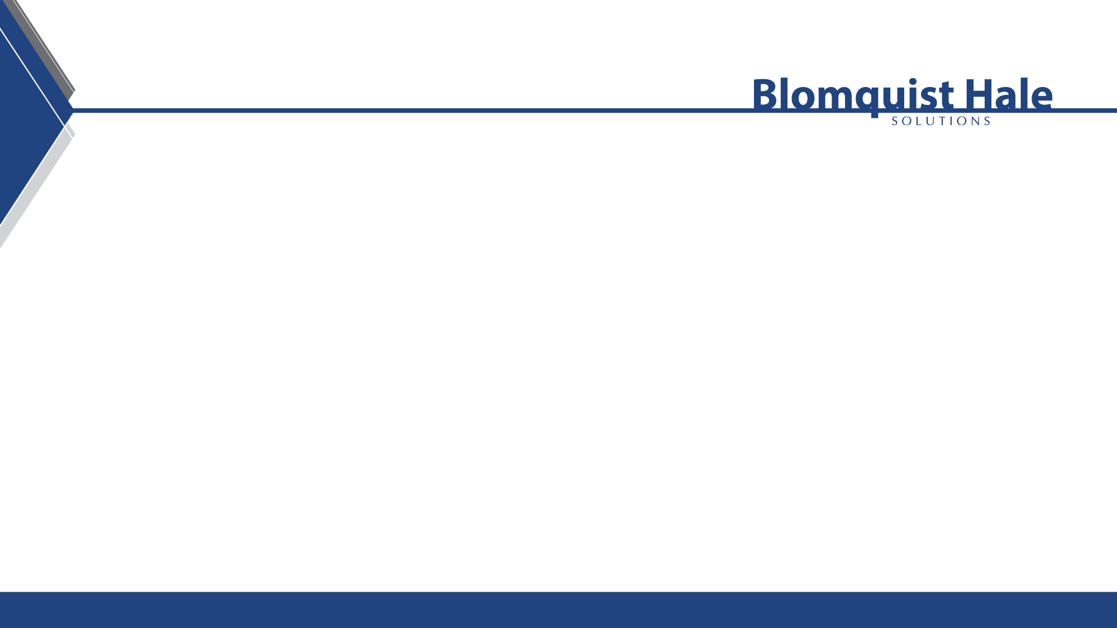
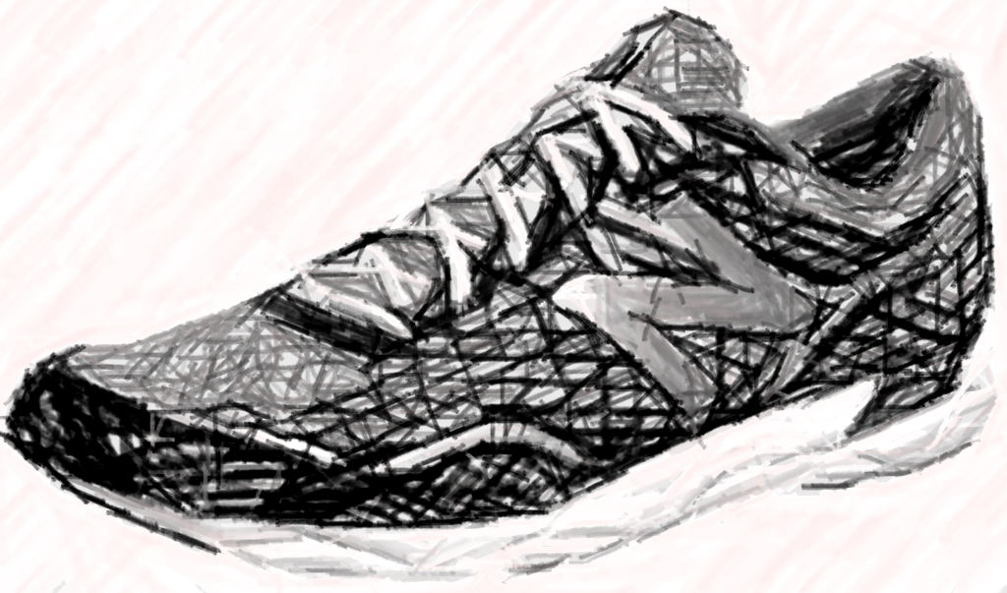
The brain needs an environment for success
CARYL ANN WARD LCMHC, CFLE
Carylscounseling@gmail.com
801.999.0179 cell

Slide 2
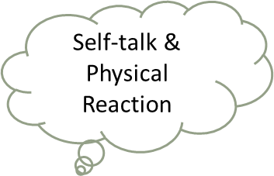


Stress, Grief, and Worry Highjack the Brain
Thoughts
Feeling
Behavior
  FRONTAL LOBE- Right/Left
    SELF-TALK
    Physical Response
    Reward System
    Reasoning
    Organizing
  *4 main reasons why we do not self-talk
  1.FFF 2.Burnout 3.Impaired 4.Mental Disorder

Slide 3
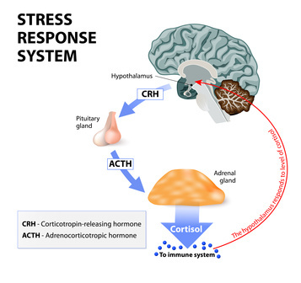
Fight/Flight/Freeze
What is your normal level of Functioning?
Stress hormones restrict
Mood, Memory, Motivation, and Management

Slide 4
Recipe for Motivation
5 R’s
Routine- Fixed Program
Responsibility-Having a Duty
Reassurance-Fears are Unseen and Real
Reward-Schedule it!
Resiliency
Takes TIME
6 Stages of Change
Caryl Ward LCMHC, CFLE ©

Slide 5
5 R’s Continued
  Routine- Find new fixed program= traditions, play, and creative TIME together
  Responsibly- Love & Logic = Choices = Power = Thinking Words not Fighting Words
  Reassurance- Model emotions by validation and empathy
            What about all those questions about fears?
  Reward- Set up a Reward System (by your child’s Love Languages) that is a distraction not avoidances
  Resilience- Instill HOPE by telling the story and knowing its takes time to change the brain. 3-6 months of Action (6 stages of change)

Slide 6
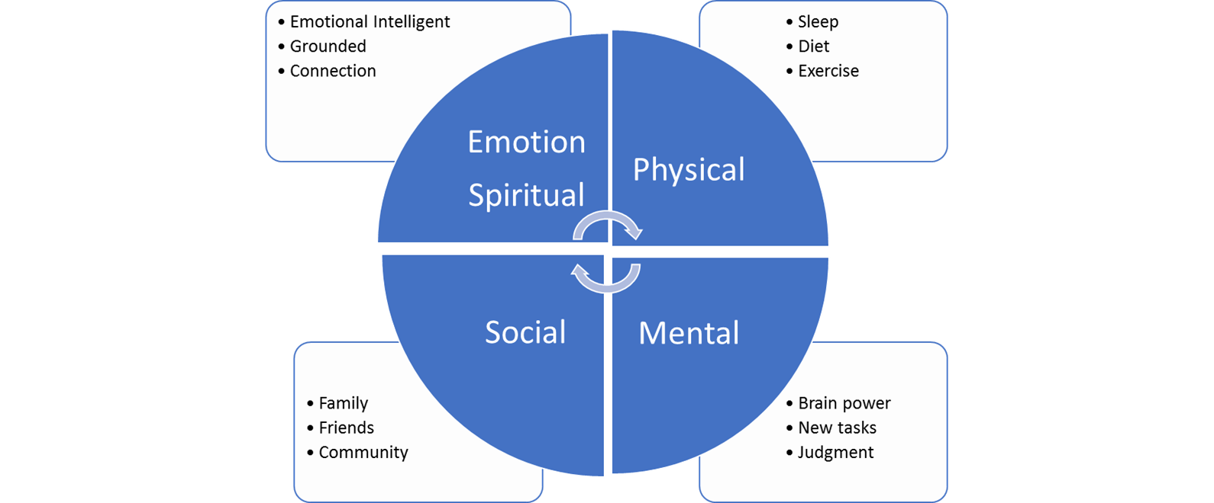
Balance not Burnout

Slide 7
Burnout Stages & Reaction
  Cognitive
Attention & processing reduces, short-term memory problems, judgment impaired, racing thoughts, ridged thinking, focus on the negative
  Emotional
Increased irritability, frustration, impatience, depression, anxiety, hopelessness, confusion, numbness
  Behavioral
Increased bad/nervous habits, sleep disturbances, impaired listening skills, withdrawal, aggression
  Physiological
Rapid heartbeat, increased fatigue, illnesses, stomach problems, nausea, dizziness, aches, decreased libido, headaches, difficulty breathing, sweating
  Honeymoon Stage
  Onset of Stress
  Chronic Stress
  Burnout
  Habitual Burnout

Slide 8
Screen Burnout
Brewer, a leading neuroscientist and psychiatrist, studies human behavior and habits. He said the first step to preventing screen burnout is to map out what is going on in our minds when we are drawn to devices and how we feel after we use them.
"What am I aiming to do? Is this to communicate with somebody? Is this because I'm forced to go on a meeting, and what is my habitual reaction?" he said. https://6abc.com/screen-time-quarantine-coronavirus-how-to-decrease/6113392/
During an in-person conversation, the brain focuses partly on the words being spoken, but it also derives additional meaning from dozens of non-verbal cues, such as whether someone is facing you or slightly turned away, if they’re fidgeting while you talk, or if they inhale quickly in preparation to interrupt.
https://www.nationalgeographic.com/science/2020/04/coronavirus-zoom-fatigue-is-taxing-the-brain-here-is-why-that-happens/

Slide 9
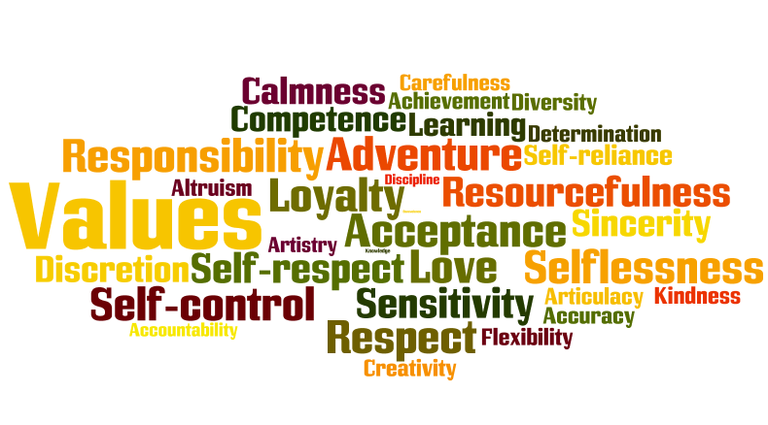
Values
Time
Energy
Money

Slide 10


Time Tips 168 Hours
Clock- Manage Time
Compass-Vision
Commitments
Appointments
Schedules
Goals/Projects
Activates
Values
Principles
Mission
Direction
Control/Power
Wake up calls—when what we do doesn’t contribute to what is most important.
(Covey 94, pg. 20)

Slide 11
Boundaries around your VALUES
Kids are hard wired to push boundaries, parents job is to hold them, not to be liked
Guardian
  Protect, preserve safety to grow in a healthy environment (something to hold on to)
Manager
  Expectations are met by correcting, teaching, enforcing and building skills
Source
  Basic needs, support, and wisdom

Slide 12
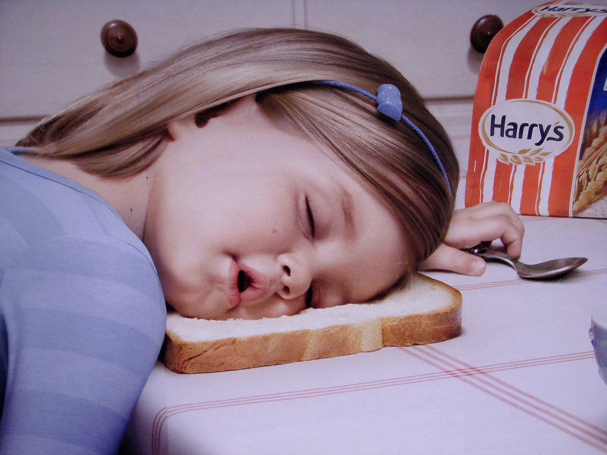
Sleep is #1
Benefits of REM sleep: better brain development, boost in memory, concentration, learning, mood, creativity, better immune system, less depression, more growth hormones, improved blood supply to muscles, better health overall, reduces heart disease and strokes and have a higher educational level.
Newborns 14-17 hours
Infants 12-15 hours
Teens 8-10 hours
Adults 7-9 hours
65 + 7-9 hours
American average- 7 hours with 35% report “poor” sleep quality. 7/10 high School age don’t get enough sleep.

Slide 13
Bed Time Hygiene
Sleep hygiene routine
Exercise/Stretch
Electronics off
  1 hour before bedtime
Relaxation techniques
  Hyper-sleep (YouTube)
Avoid caffeine
Reduce or avoid naps
  Get out of your bed if awake
20 minute rule
Read
  Outside your bed
Journal
  Mind dump worries/emotions
Magnesium
  (citrate//glycine/chloride, Calm)

Slide 14
Clean up Your Environment
Self/Physical/Emotional
Spiritual
Relationships
Work/
Network
Financial
Nature
Home

Slide 15

Mindfulness Work
The focus is on what’s right in front of you, turning to your physical sensations with full awareness. Letting go of thoughts of the past or future without judgment.
  2-10 Minute Distraction to Break the Urge
  Pause throughout the day with present mindfulness, walking, eating, imagery, or body scan
Ways to Calm the Autonomic (Sympathetic) Nervous System
  Four Square Breathing
  Trace or Color or Record Feelings
  Focus Point (hold a pen 6 inches from eyes)
  Call Someone
  Room Scan and Use 5 senses (point out what you see etc.)
  Worry Bag (to take with you places)
http://www.freemindfulness.org/download
http://www.livingwell.org.au/mindfulness-exercises-3/8-mindfulness-of-thoughts/

Slide 16
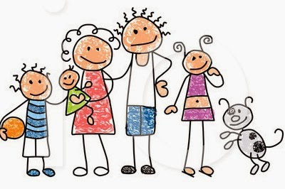
Highly Effective Families
What single thing that we should be doing regularly to make a big change in your life lines up with your values?
Family Connection
  Hot topic time-once a week for 30 minutes
  Family mission statement and top 5 values
  Family one on one boss time (each child)
  Mandatory family fun time
  Family dinner
  Clean up an environment
  Balance

Slide 17
Coping for Family/Self
Good Distractions 10 minutes-2 hours
vs. Avoidances-2 hours plus
Creative Play Activates
Limit Screen Time/Media
Increase Humor
Routine
Timer as the BOSS
Reach OUT!
  UTAH SAFE APP
  SUICIDE CRISIS LINE 1-800-273-TALK
  DOMESTIC VIOLENCE 1-800-897-LINK (5465)
  CrisisLine-801-587-3000
Improve Balance
Mindfulness
Logic and Emotion Together (wisemind)
Create a Mental “Safe Space”
Reduce Caffeine
Connection
Reduce Thinking Errors
Clean up Your Environment
Create a Reward System
Mini Vacations
Do the Best You Can!!

Slide 18

Finish Line
"The miracle isn't that I finished. The miracle is that I had the courage to start."
—John Bingham
https://www.youtube.com/watch?v=_X0mgOOSpLU&feature=emb_logo

Slide 19
Reference
Brown (2010). The Gifts of Imperfection: Let Go of Who You Think You’re Supposed to Be and Embrace Who You Are
Chapman and Campbell (2012) The Five Love Languages of Children
Cline, Fay (2016) Parenting Teens With Love And Logic: Preparing Adolescents for Responsible Adulthood
Covey, S. R. (1997). The 7 habits of highly effective families: building a beautiful family culture in a turbulent world. New York: Golden Books.
Covey, S. R. (2004). The 7 habits of highly effective people: Restoring the character ethic. New York: Free Press.
Covey, S. R., Merrill, A. R., & Merrill, R. R. (1994). First things first: To live, to love, to learn, to leave a legacy.
Gottman (1997) Raising An Emotionally Intelligent Child
Maslash, C. & M. P. Letter, (2015) It’s Time to Take Action on Burnout. Burnout Research 2, IV-V
Peck, M. S. (1978). The road less traveled: A new psychology of love, traditional values, and spiritual growth. New York: Simon and Schuster.
Siegel, D. J. (2013). Brainstorm: The power and purpose of the teenage brain.
https://www.sleepfoundation.org/articles/why-your-child-needs-sleep-schedule-throughout-summer
https://www.youtube.com/watch?v=Kvs-_22lwjA (Dr. Wayne 5 mins before bed positive affirmations)
https://www.youtube.com/watch?v=Z459cW8C3i0
https://www.youtube.com/watch?v=_X0mgOOSpLU&feature=emb_logo

