Slide 1
Conflict Resolution & Anger Management CARYL WARD LCMHC, CFLE carylscounseling@gmail.com 801.999.0179 cell

Slide 2
Domestic Violence
“Domestic violence" or "domestic violence offense" means any criminal offense involving violence or physical harm or threat of violence or physical harm, or any attempt, conspiracy, or solicitation to commit a criminal offense involving violence or physical harm, when committed by one cohabitant against another. "Domestic violence" or "domestic violence offense" includes commission or attempt to commit, any of the following offenses by one cohabitant against another: https://le.utah.gov/xcode/Title77/Chapter36/77-36-S1.html
*42% of all Utah homicides are domestic violence related.
Hotline 24/7- 1.800.897.LINK(5465)
The Salt Lake City Police Department’s crisis line is 801-580-7969.
The National Domestic Violence Hotline is 1-800-799-7233.
The YWCA can be reached at (801) 537-8600.

Slide 3
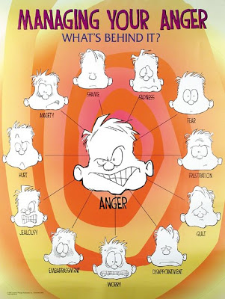
Define Anger
Three types of anger are
Aggressive- Direct with Disrespect
Passive Aggressive- Yes but you mean No
Passive- Everyone is Right and You are Wrong
Assertive- Direct with Respect (I feel, I need)
Clues-
Emotional
Physical
Behavioral

Slide 4
Define Anger Anger is a secondary emotion from Mad.
Frustration
Outraged
Insecure
Lonely
Worthless
Jealous
Annoyed
Hurt
Resentment
Feeds the Root of
Loss, Grief Powerless

Slide 5
Anger Myth’s
Anger is inherited
Anger leads to aggression/Rage
Anger gets what you want
Anger is not a habit
Anger is a primary emotion
Venting anger physically is therapeutic

Slide 6
When Anger Leads to Behavior
When anger leads to aggressive behavior of abuse (harm to self or others) and consequences follow
Impairment in the Court System
Road Rage
Breaking of Family Values/Rules
When you have a pay off
Broken Trust
Passive Aggressive->Manipulative->Vindictive
Thought
Feeling
Behavior

Slide 7
When Behavior Leads to Burnout
What is your normal level of Functioning? Stress hormones restrict Mood, Memory, Motivation, and Management
Cognitive
Attention & processing reduces, short-term memory problems, judgment impaired, racing thoughts, ridged thinking, focus on the negative
Emotional
Increased irritability, frustration, impatience, depression, anxiety, hopelessness, confusion, numbness
Behavioral
Increased bad/nervous habits, sleep disturbances, impaired listening skills, withdrawal, aggression
Physiological
Rapid heartbeat, increased fatigue, illnesses, stomach problems, nausea, dizziness, aches, decreased libido, headaches, difficulty breathing, sweating

Slide 8
Define Conflict
A clash of interest. The basis of conflict may vary but, it is always a part of environmental or root issues. The root of conflict may be personal (internal), racial, class, social, political and universal. Conflict in groups often follows a specific course. Many conflicts are a thinking error story without facts.
Compassion is connecting with the right person, over the right issue, at the right time.
Clues-
Emotional
Physical
Behavioral

Slide 9
Conflict Myths
Conflict will lead to….anger, blame, resentment, etc.
Conflict needs to be addressed immediately
Conflict is not normal
Conflict is not safe
Conflict is better when avoided
Conflict needs to be solved/fixed

Slide 10
Conflict Cycle
Trust and Saftey First
Listen for Concern
Ask Clarifying Questions
Restate Their Concern with Empathy
Negotiate if Possible
Set Clear Expectations

Slide 11
How to Manage the Root Issues
Leafy Issue
Failed relationships, Financial Issues
Trunk 2nd Emotions
Hurt, Inadequate, Raw, Stuck
Root Issue
Loss, Grief, Trauma, Self-Concept, Shame

Slide 12
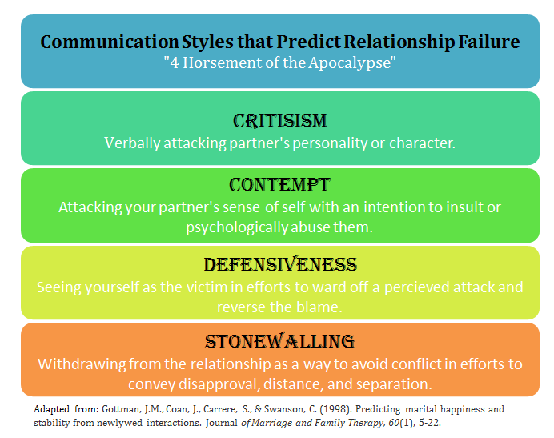
Gottman 4 Horseman

Slide 13
Couple/Family Hot Topic Time
*Set a time to bring up Hot Topics that have been written down in a notebook or jar. 1 x a week for 30 min. Make prior safety rules.

Slide 14
Repair Check List /Fair Fighting
Before you begin, ask yourself what is your goal.
Discuss one issue at a time.
No degrading language/ No yelling.
Express your feelings with words and take responsibility for them.
Take turns talking.
No stonewalling (one of the 4 horseman).
Take a time-out if things get too heated
Attempt to come to a compromise and understanding.

Slide 15
Tips to Reduce Conflict
Time Outs (10 mins.-24 hours)
Thought Stopping (this is unfair, see handout)
Stay Present (don’t jump to conclusion)
Know what is REALLY going on (root issue)
Be emotionally intelligent (2nd emotions ex. defensive)
Listen to Seek to Understand (habit 5 in Steven Covey)
Logical impact (self-talk the risks)
Find a win-win and manage it (business deal)

Slide 16
Resources
Covey, S. R. (1989). The seven habits of highly effective people: restoring the character ethic. New York: Simon and Schuster.
Gottman, J. M., & Silver, N. (1999). The seven principles for making marriage work. New York: Three Rivers Press.
https://www.gottman.com/blog/the-four-horsemen-recognizing-criticism-contempt-defensiveness-and-stonewalling
Lerner, H. G. (1986). The dance of anger: A woman's guide to changing the patterns of intimate relationships.
Lerner, H. G. (2017). Why won’t you apologize? Healing big betrayals and everyday hurts.
Patterson, Kerry. (Eds.) (2012) Crucial conversations: tools for talking when stakes are high New York : McGraw-Hill

